Slide 1
NORTHEASTERN UNIVERSITY
College of Engineering
INFO5100 Application Engineering and Development
Final Project Presentation
A city-based delivery system
Ranran He
Yunyi Wu
Yuchi Kuang

Slide 2
Problem Statement
• People usually have to choose a delivery company first, then a restaurant it cooperates with.
• Restaurants usually get order request from the delivery company instead of directly from customers.
• Restaurants and Stores have separated delivery systems.

Slide 3
Approach
• Customers, restaurants, stores and delivery companies will share the same platform.
• Customer will send order request directly to restaurants/stores.
• Restaurants/Stores select delivery company and send delivery request to it.

Slide 4
Use Cases
All Users
• Login
• View/Modify personal information
• Change password
Customer
• Registration
• View restaurants/stores details under selected city
• Add item into shopping cart
• View/Update/Clear shopping cart
• Place order
• View order history
• Write/View reviews
• Rate restaurant/store

Slide 5
Use Cases
Restaurant/Store Manager
• View restaurant/store information
• View/Confirm/Cancel order
• View all employees
• View/Add/Edit/Remove dash/product
• View/Select available delivery companies
• View rate & reviews
Restaurant/Store Boss
• Have all Manager’s accesses
• Edit restaurant/store information
• Add/Edit/Remove manager

Slide 6
Use Cases
Delivery Company Manager
• View delivery company information
• View/Confirm/Cancel order
• View all employees
• Add/Edit/Remove employee (delivery man)
• View/Cancel delivery request
Delivery Company Boss
• All manager’s accesses
• Edit delivery company information
• Add/Edit/Remove employee (manager)
Delivery Man
• View available/own delivery request
• Update delivery status

Slide 7
Use Cases
System Manager
• View/Add/Update/Remove network
• View/Add/Update/Remove restaurant/store/delivery company.
• View/Add/Update/Remove customer account
• All restaurant/store/delivery company bosses’ accesses
• Search customer comprehensively (based on username, name, email and phone)
• See ranked customer list (by total purchased amount)

Slide 8
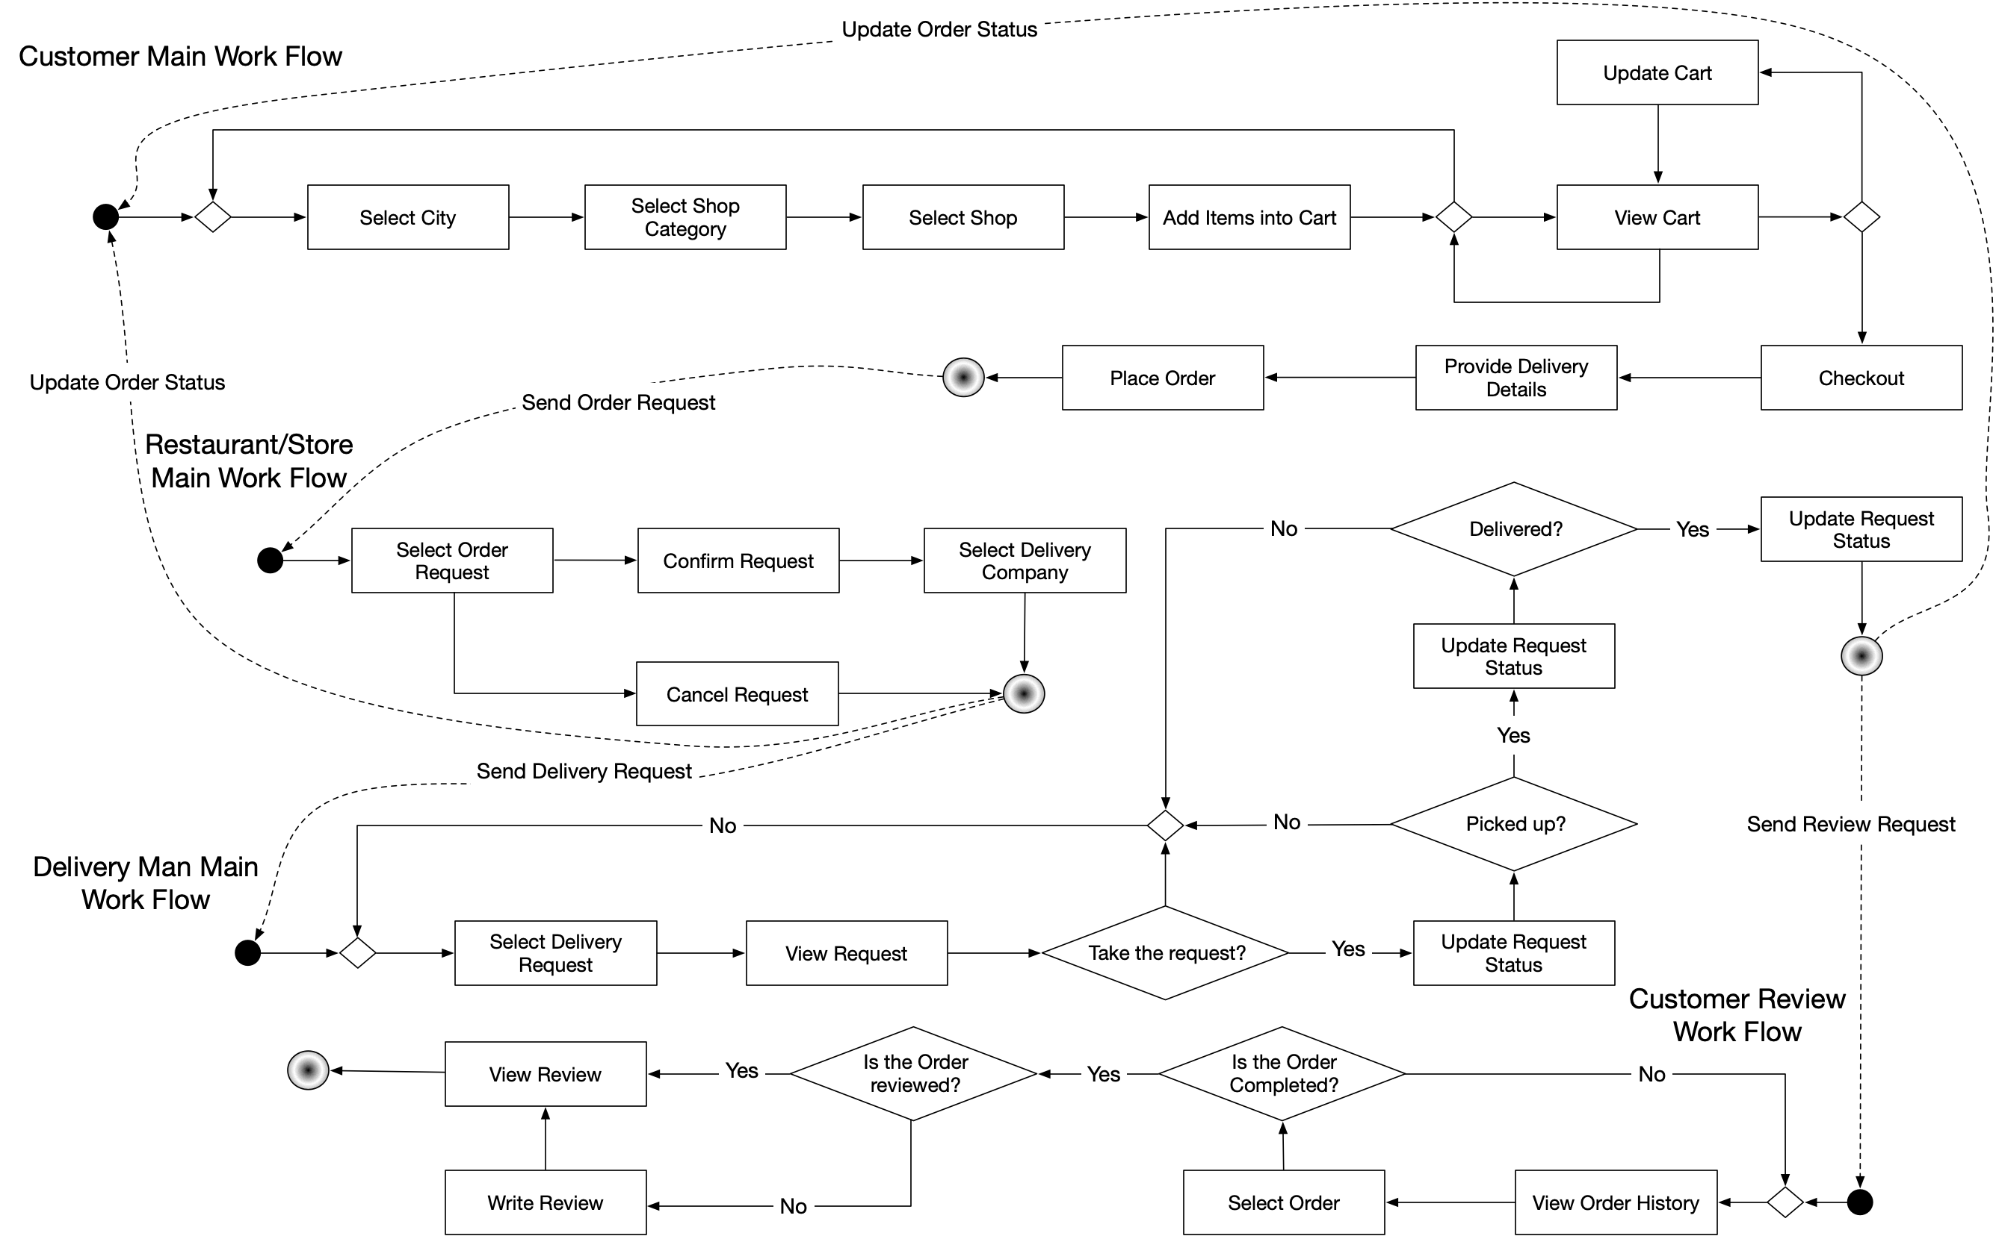
Workflow

Slide 9
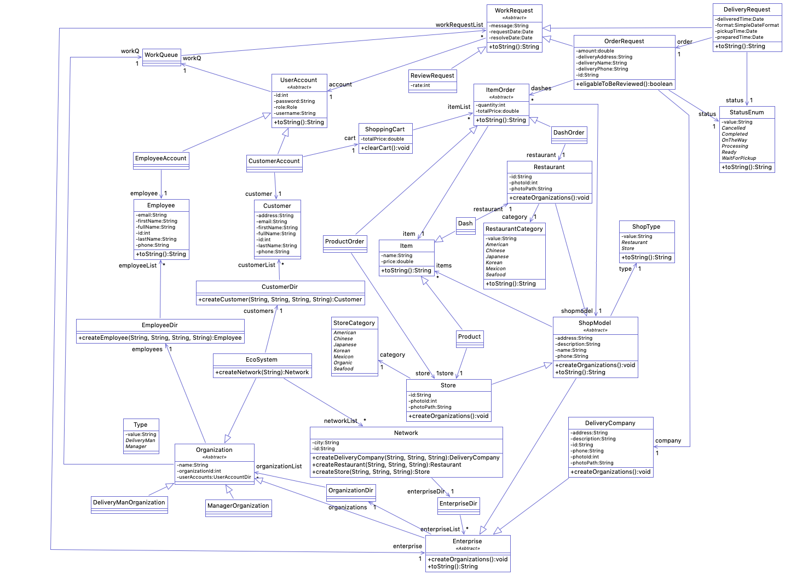
UML

Slide 10

UML
System – Network – Enterprise - Organization Level

Slide 11

UML
Enterprise Category:
Delivery Company
Restaurant
Store

Slide 12

UML
Organization Category:
DeliveryMan Organization
Manager Organization

Slide 13

UML
Account Category:
Customer Account
Employee Account

Slide 14

UML
Work Request Category:
Order Request
Delivery Request
Review Request

Slide 15
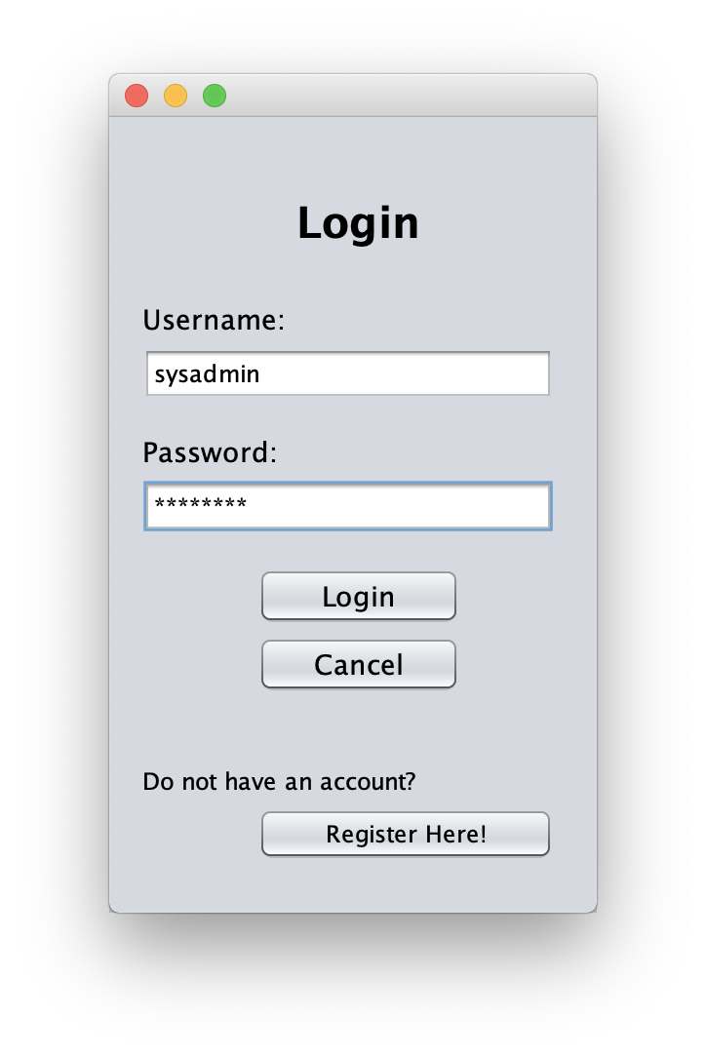
DEMO - Login
For all the users.

Slide 16
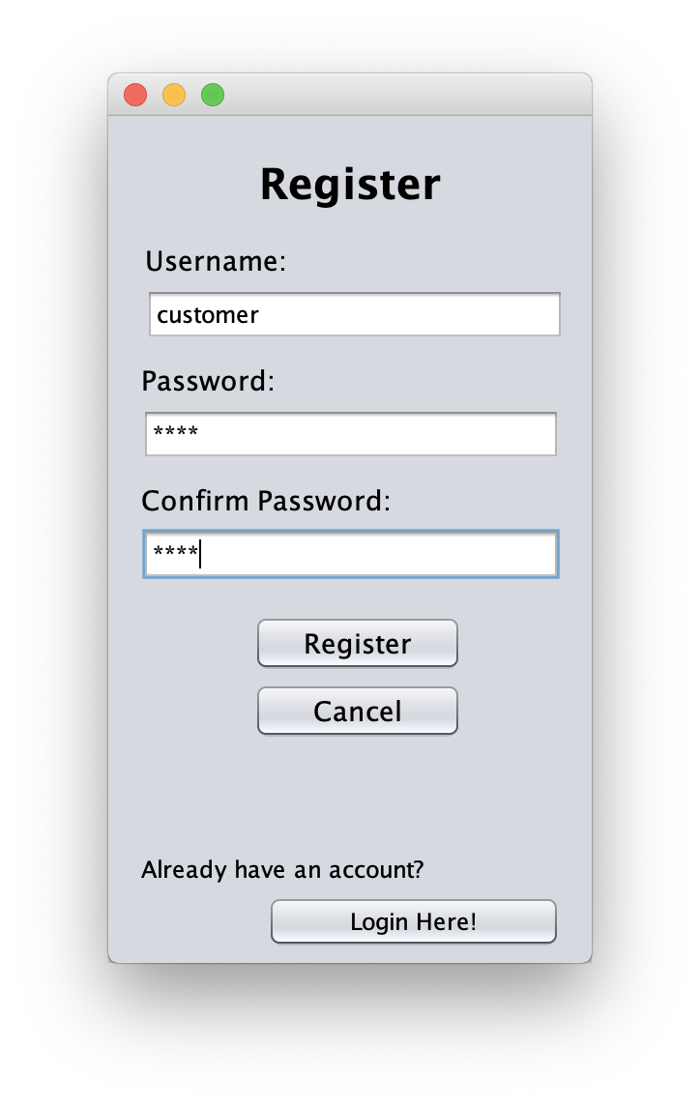
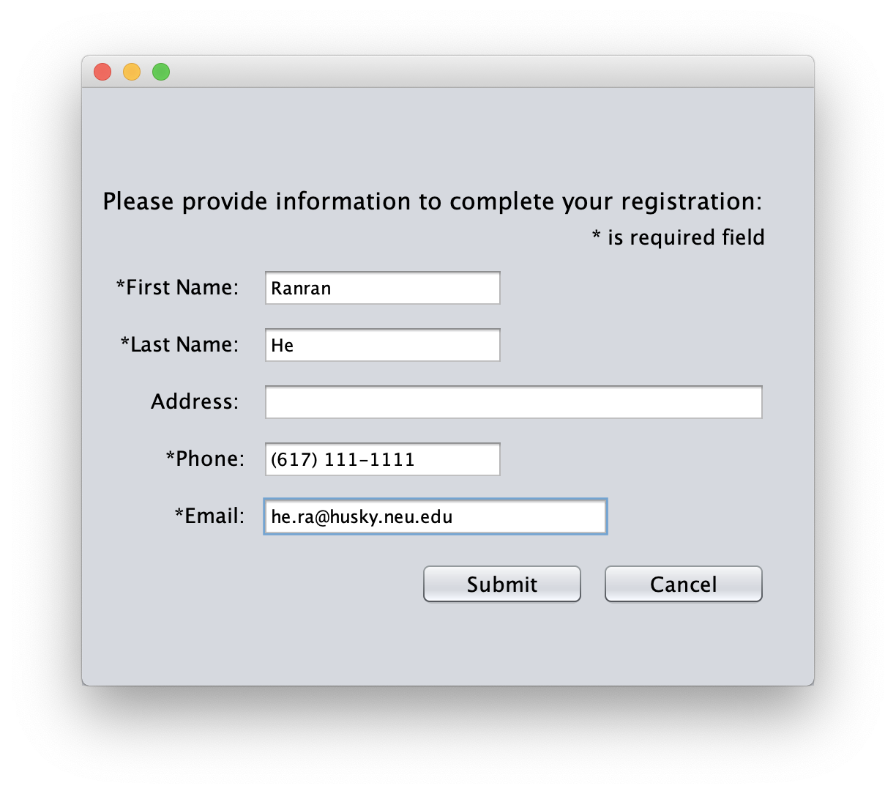
DEMO - Customer Registration

Slide 17
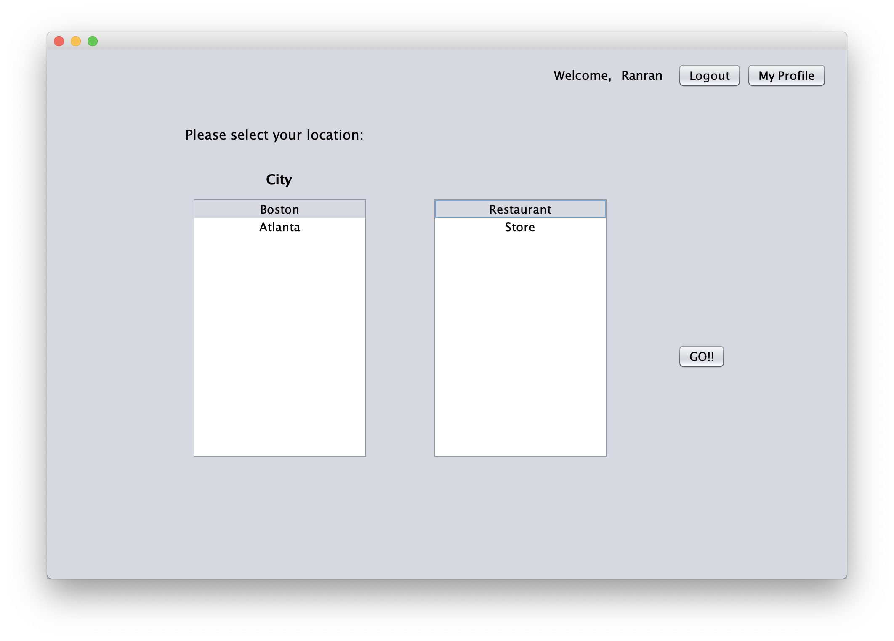
DEMO – Customer Main Page

Slide 18
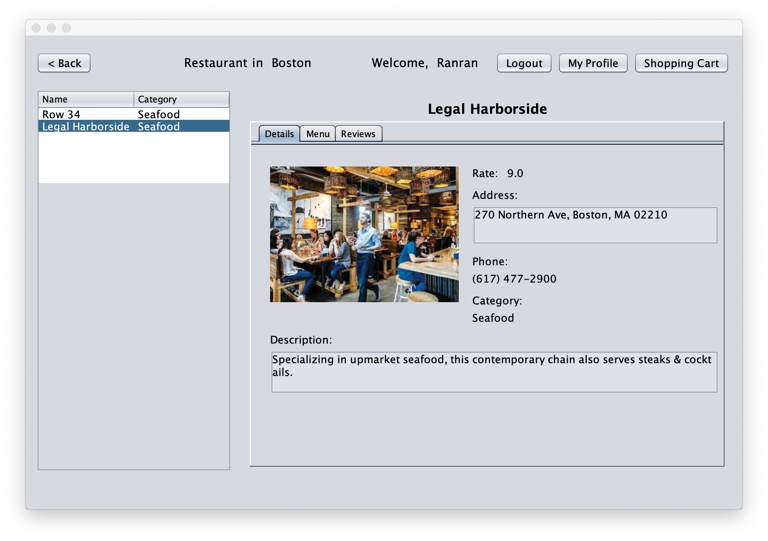
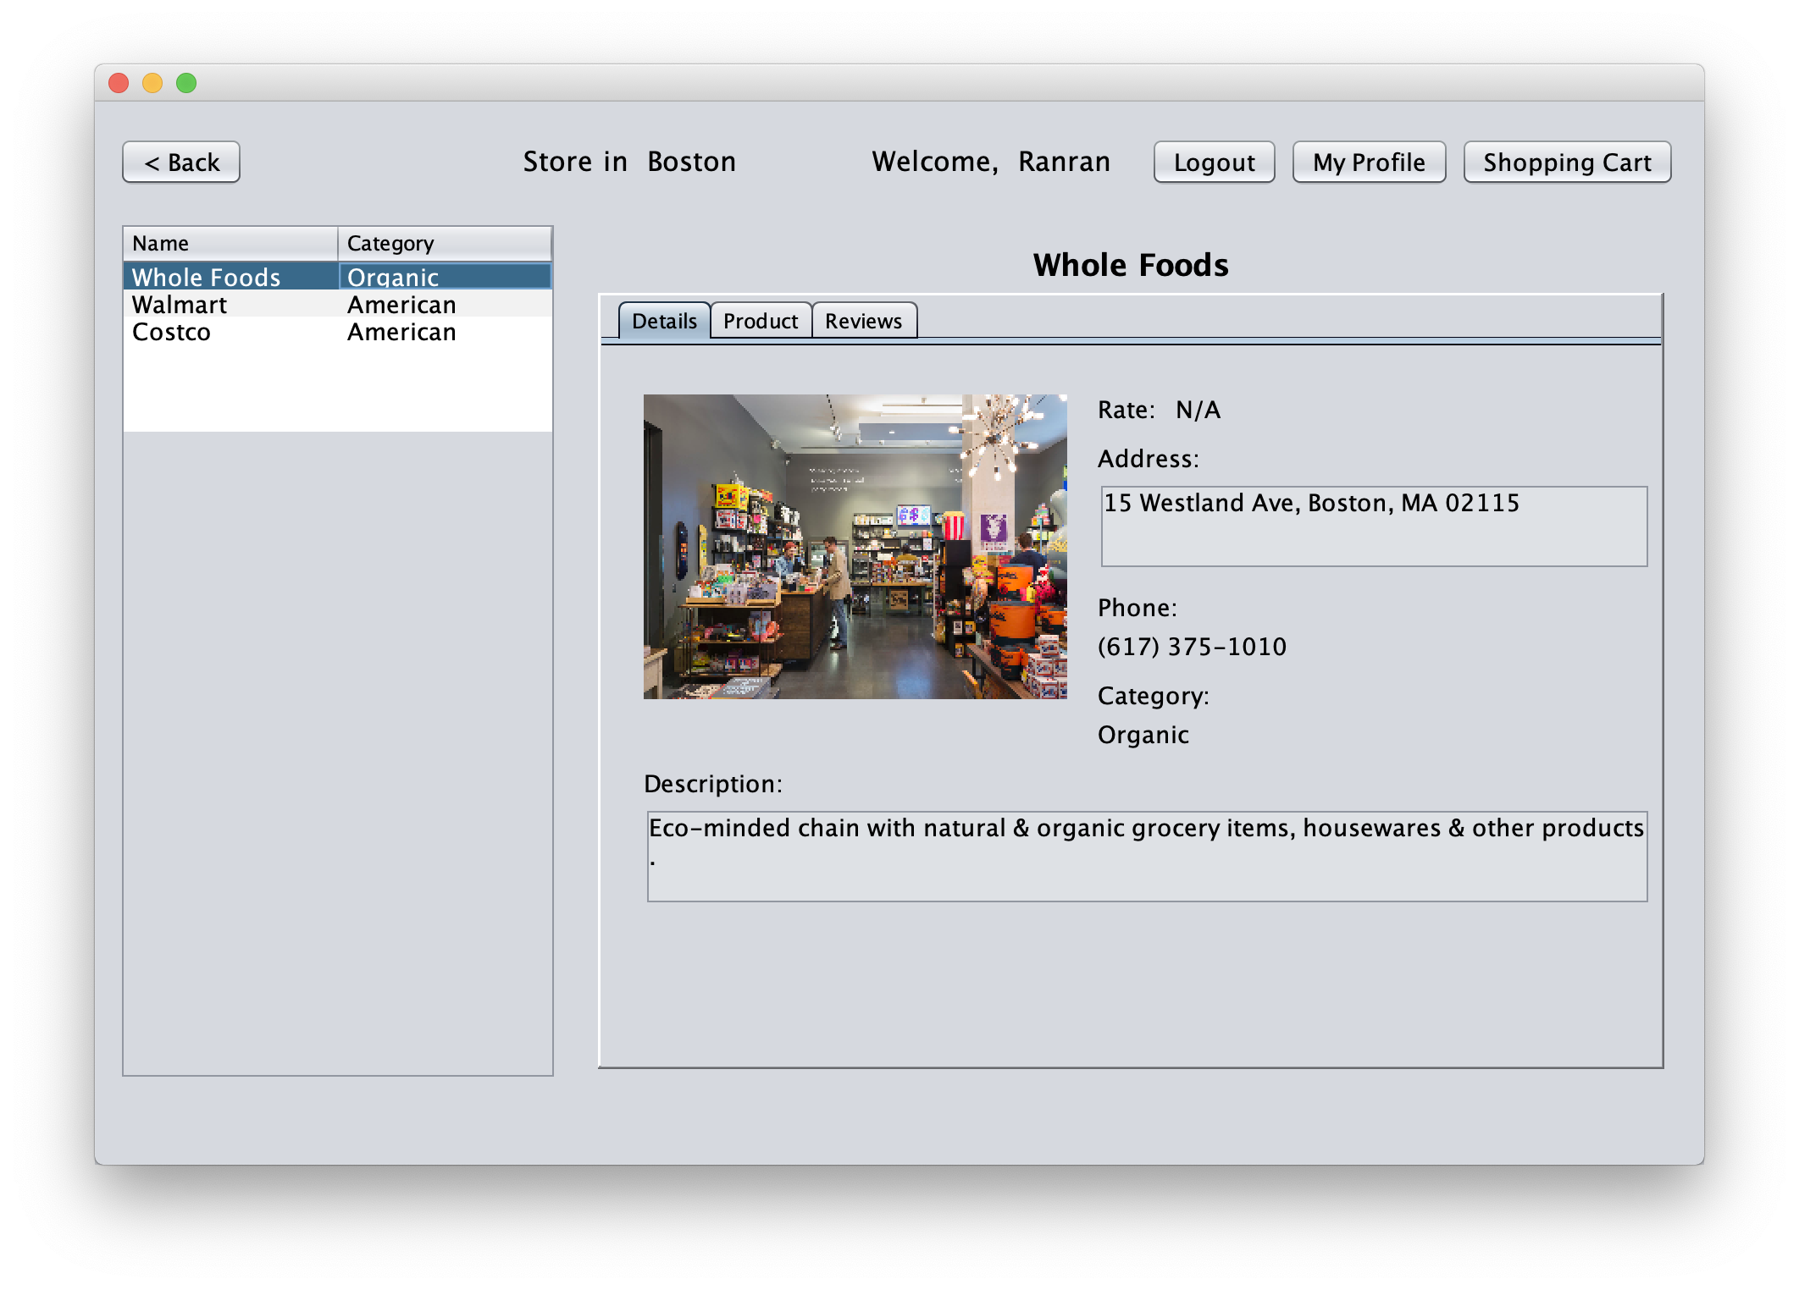
DEMO – Restaurant/Store List & Details

Slide 19
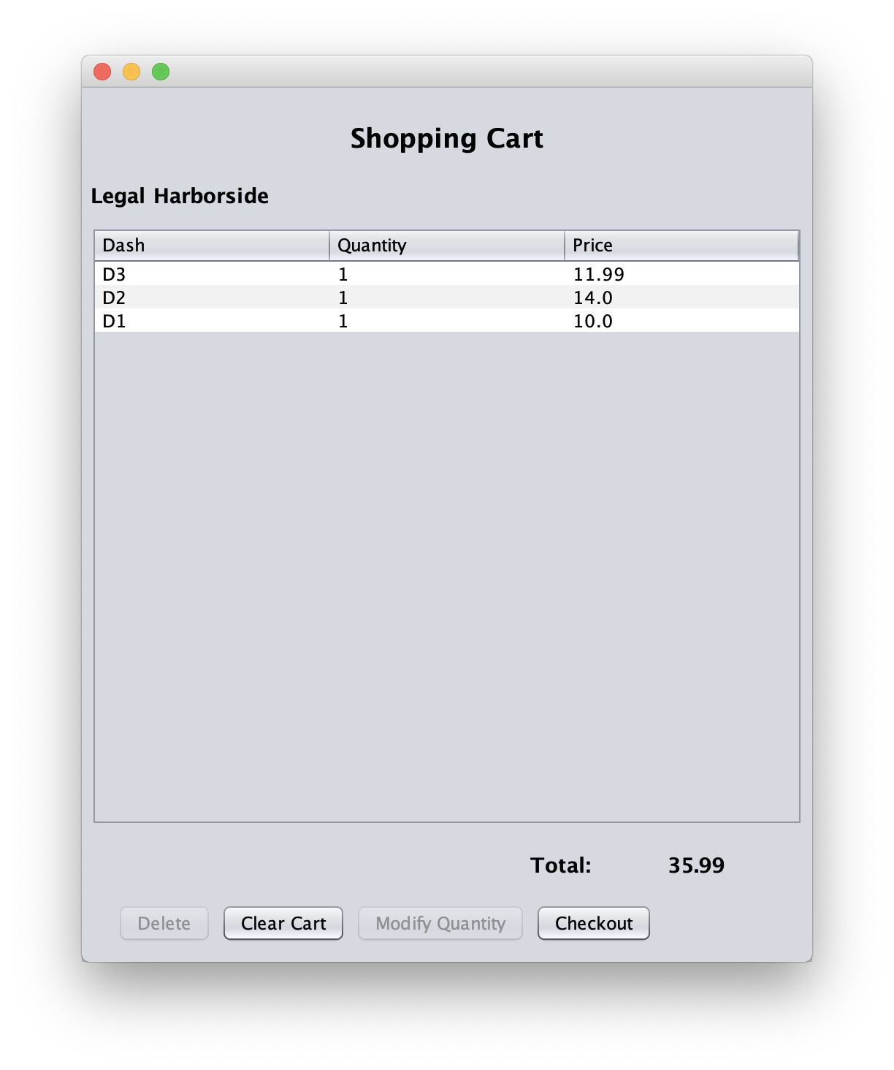
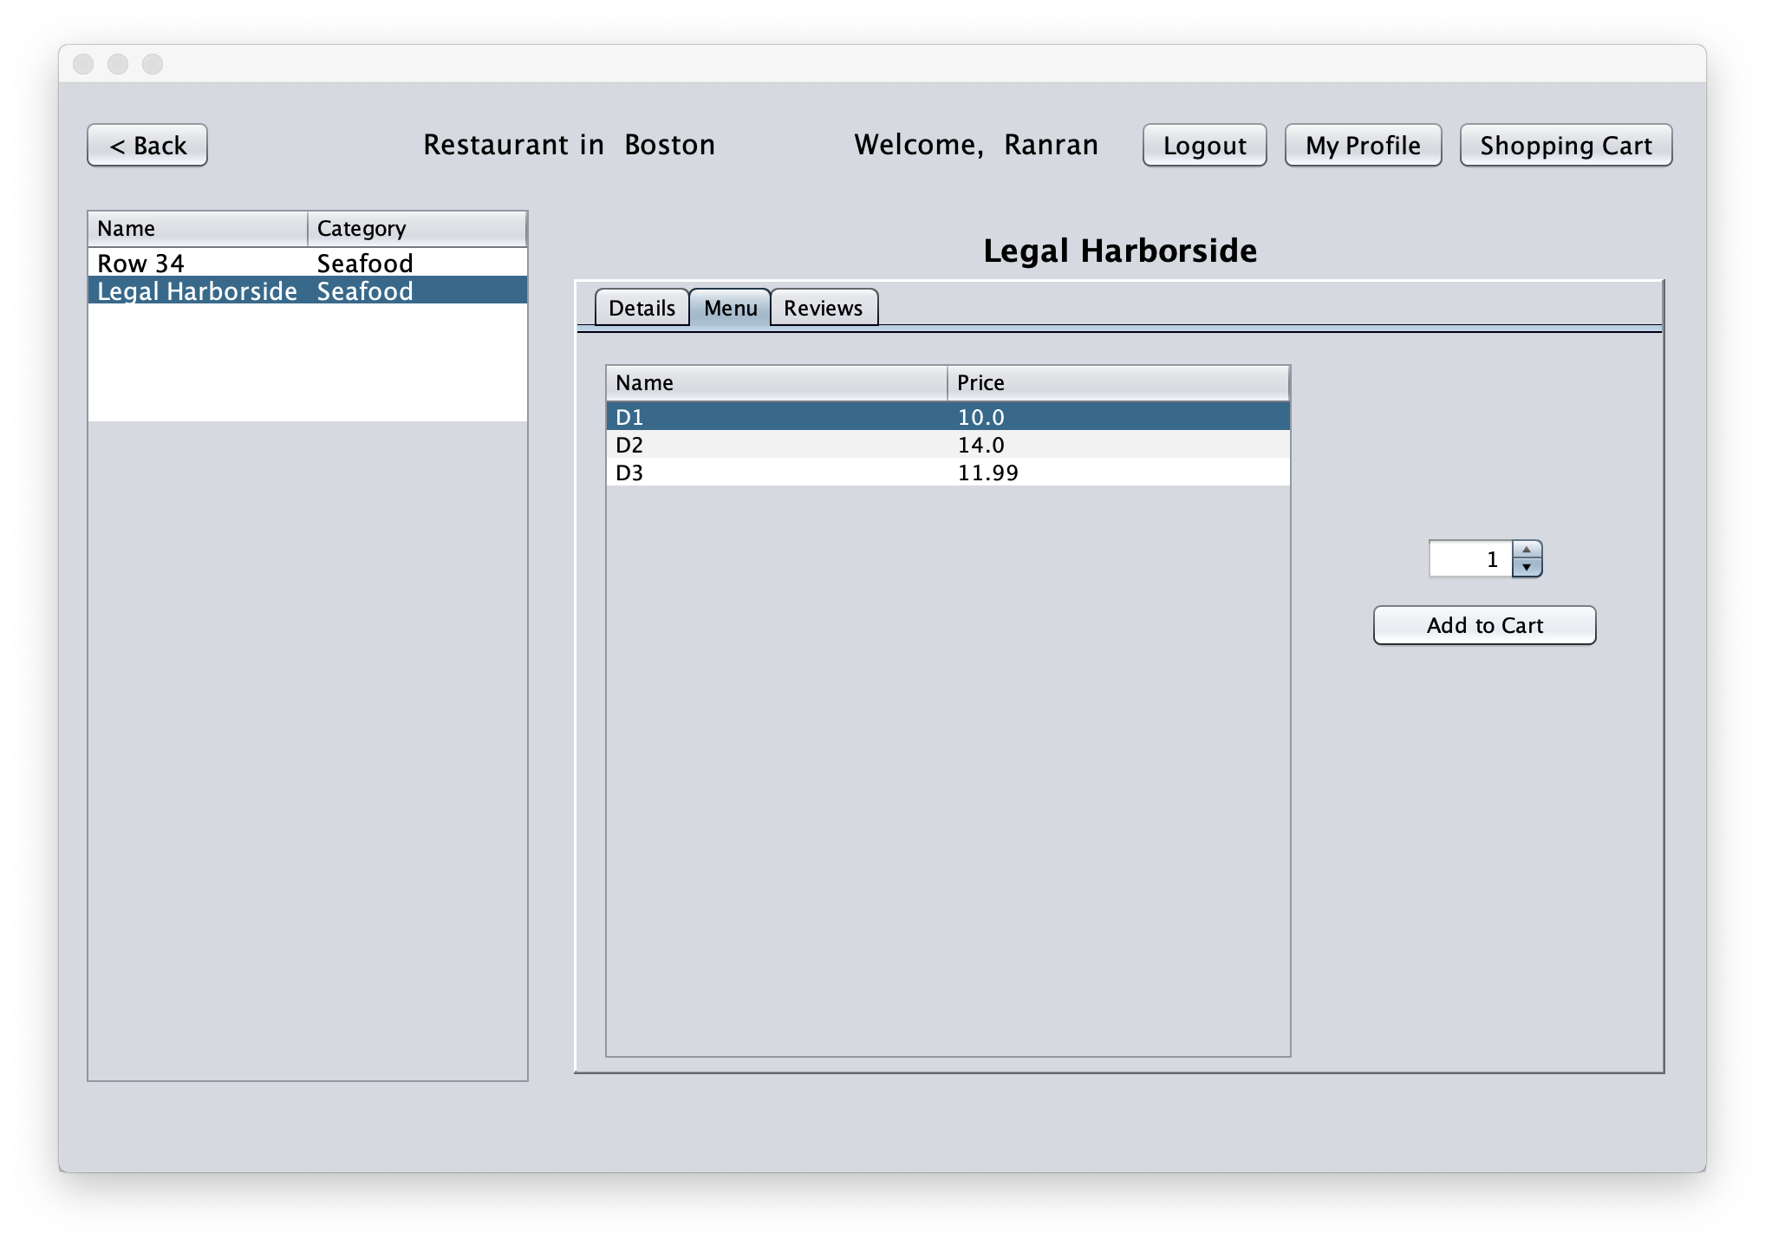
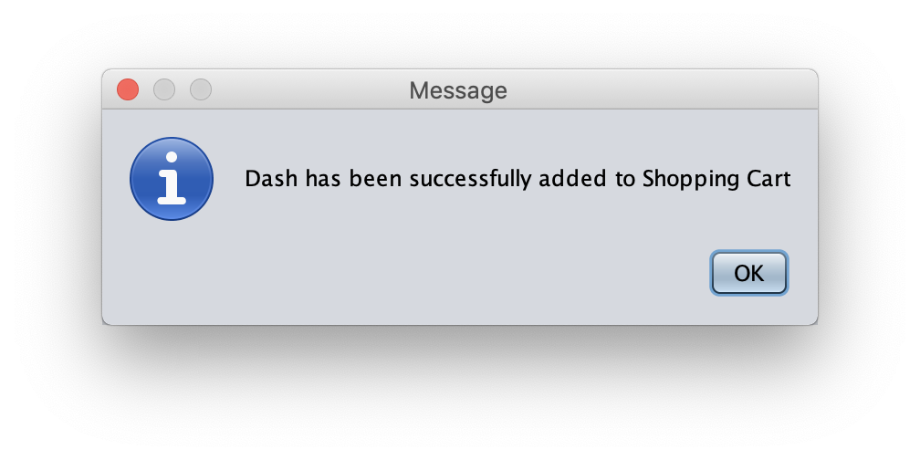
DEMO – Add to Shopping Cart

Slide 20
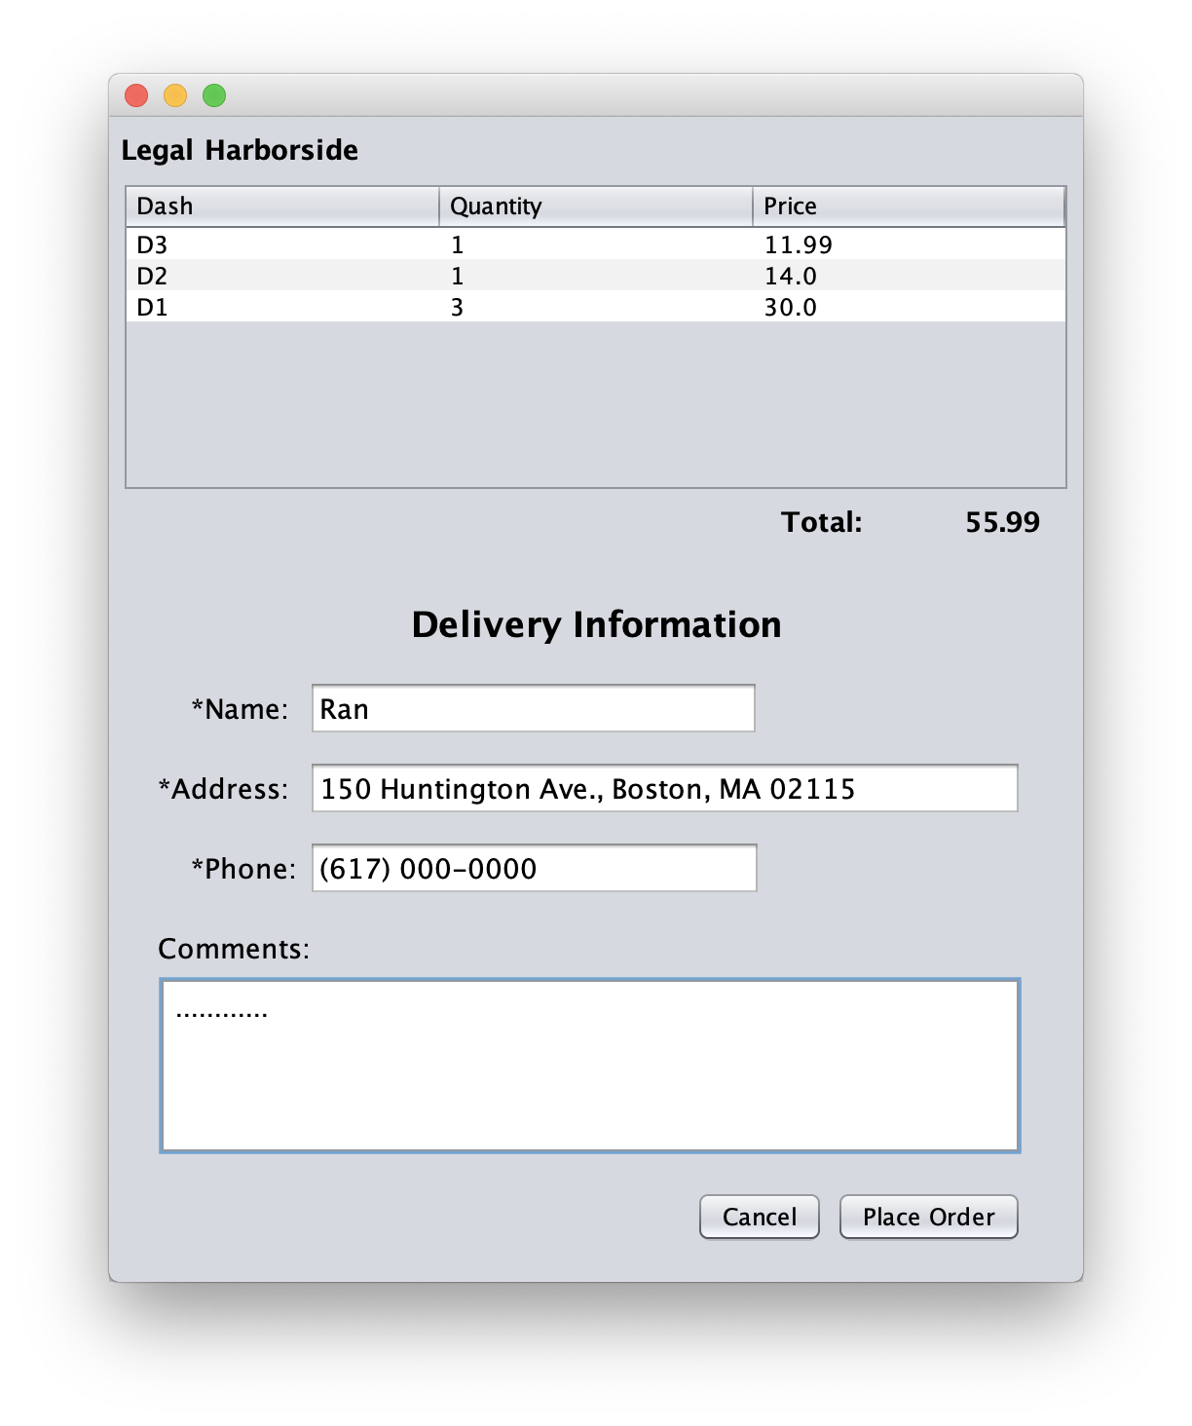
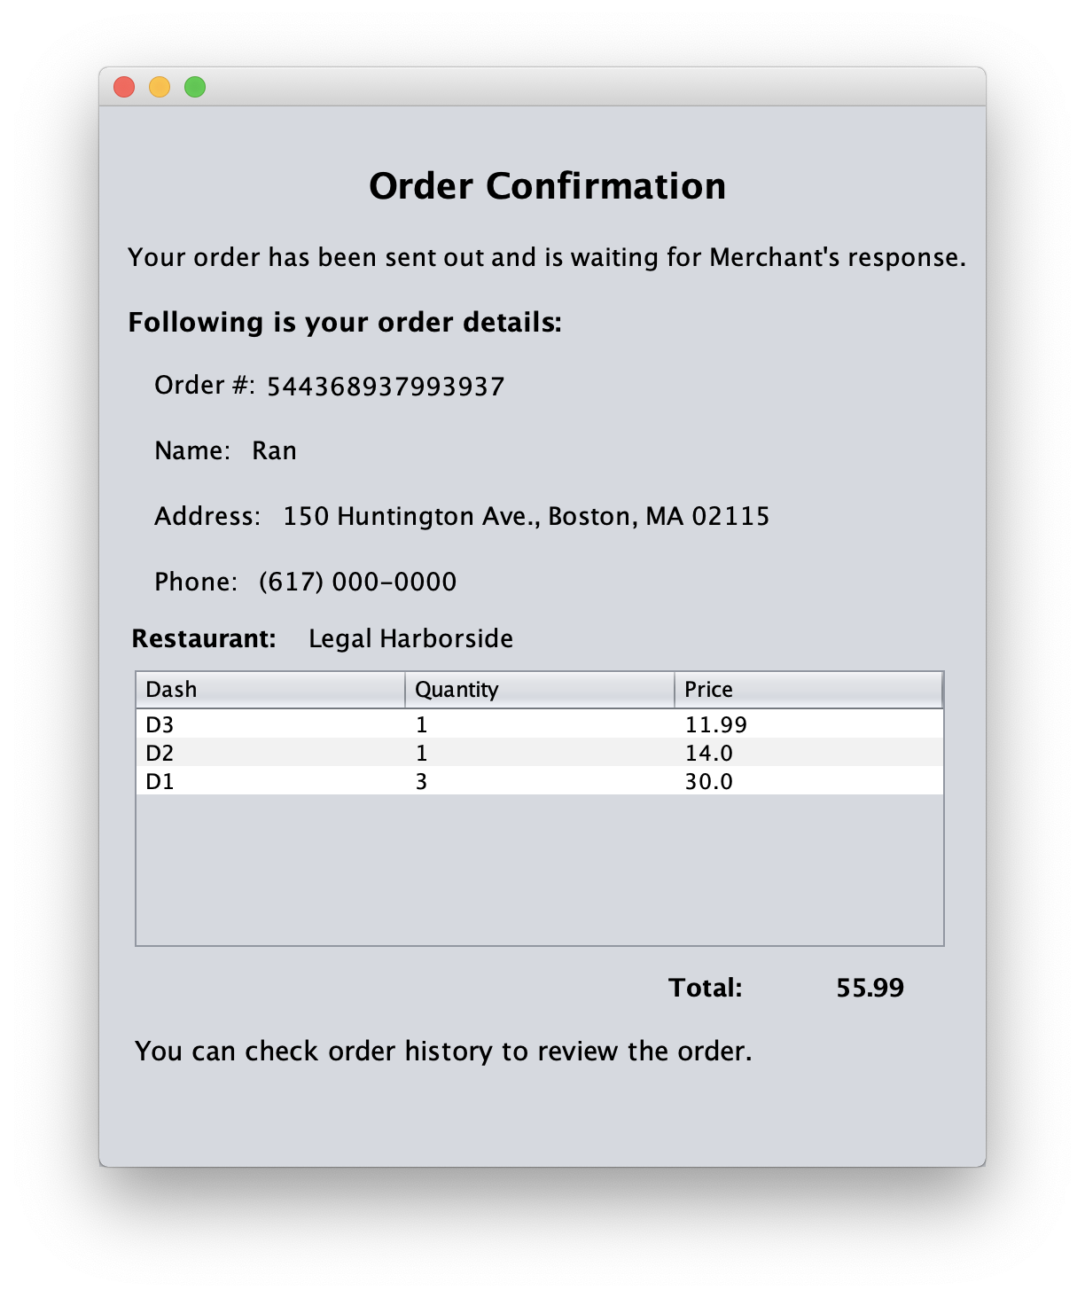
DEMO – Place Order

Slide 21
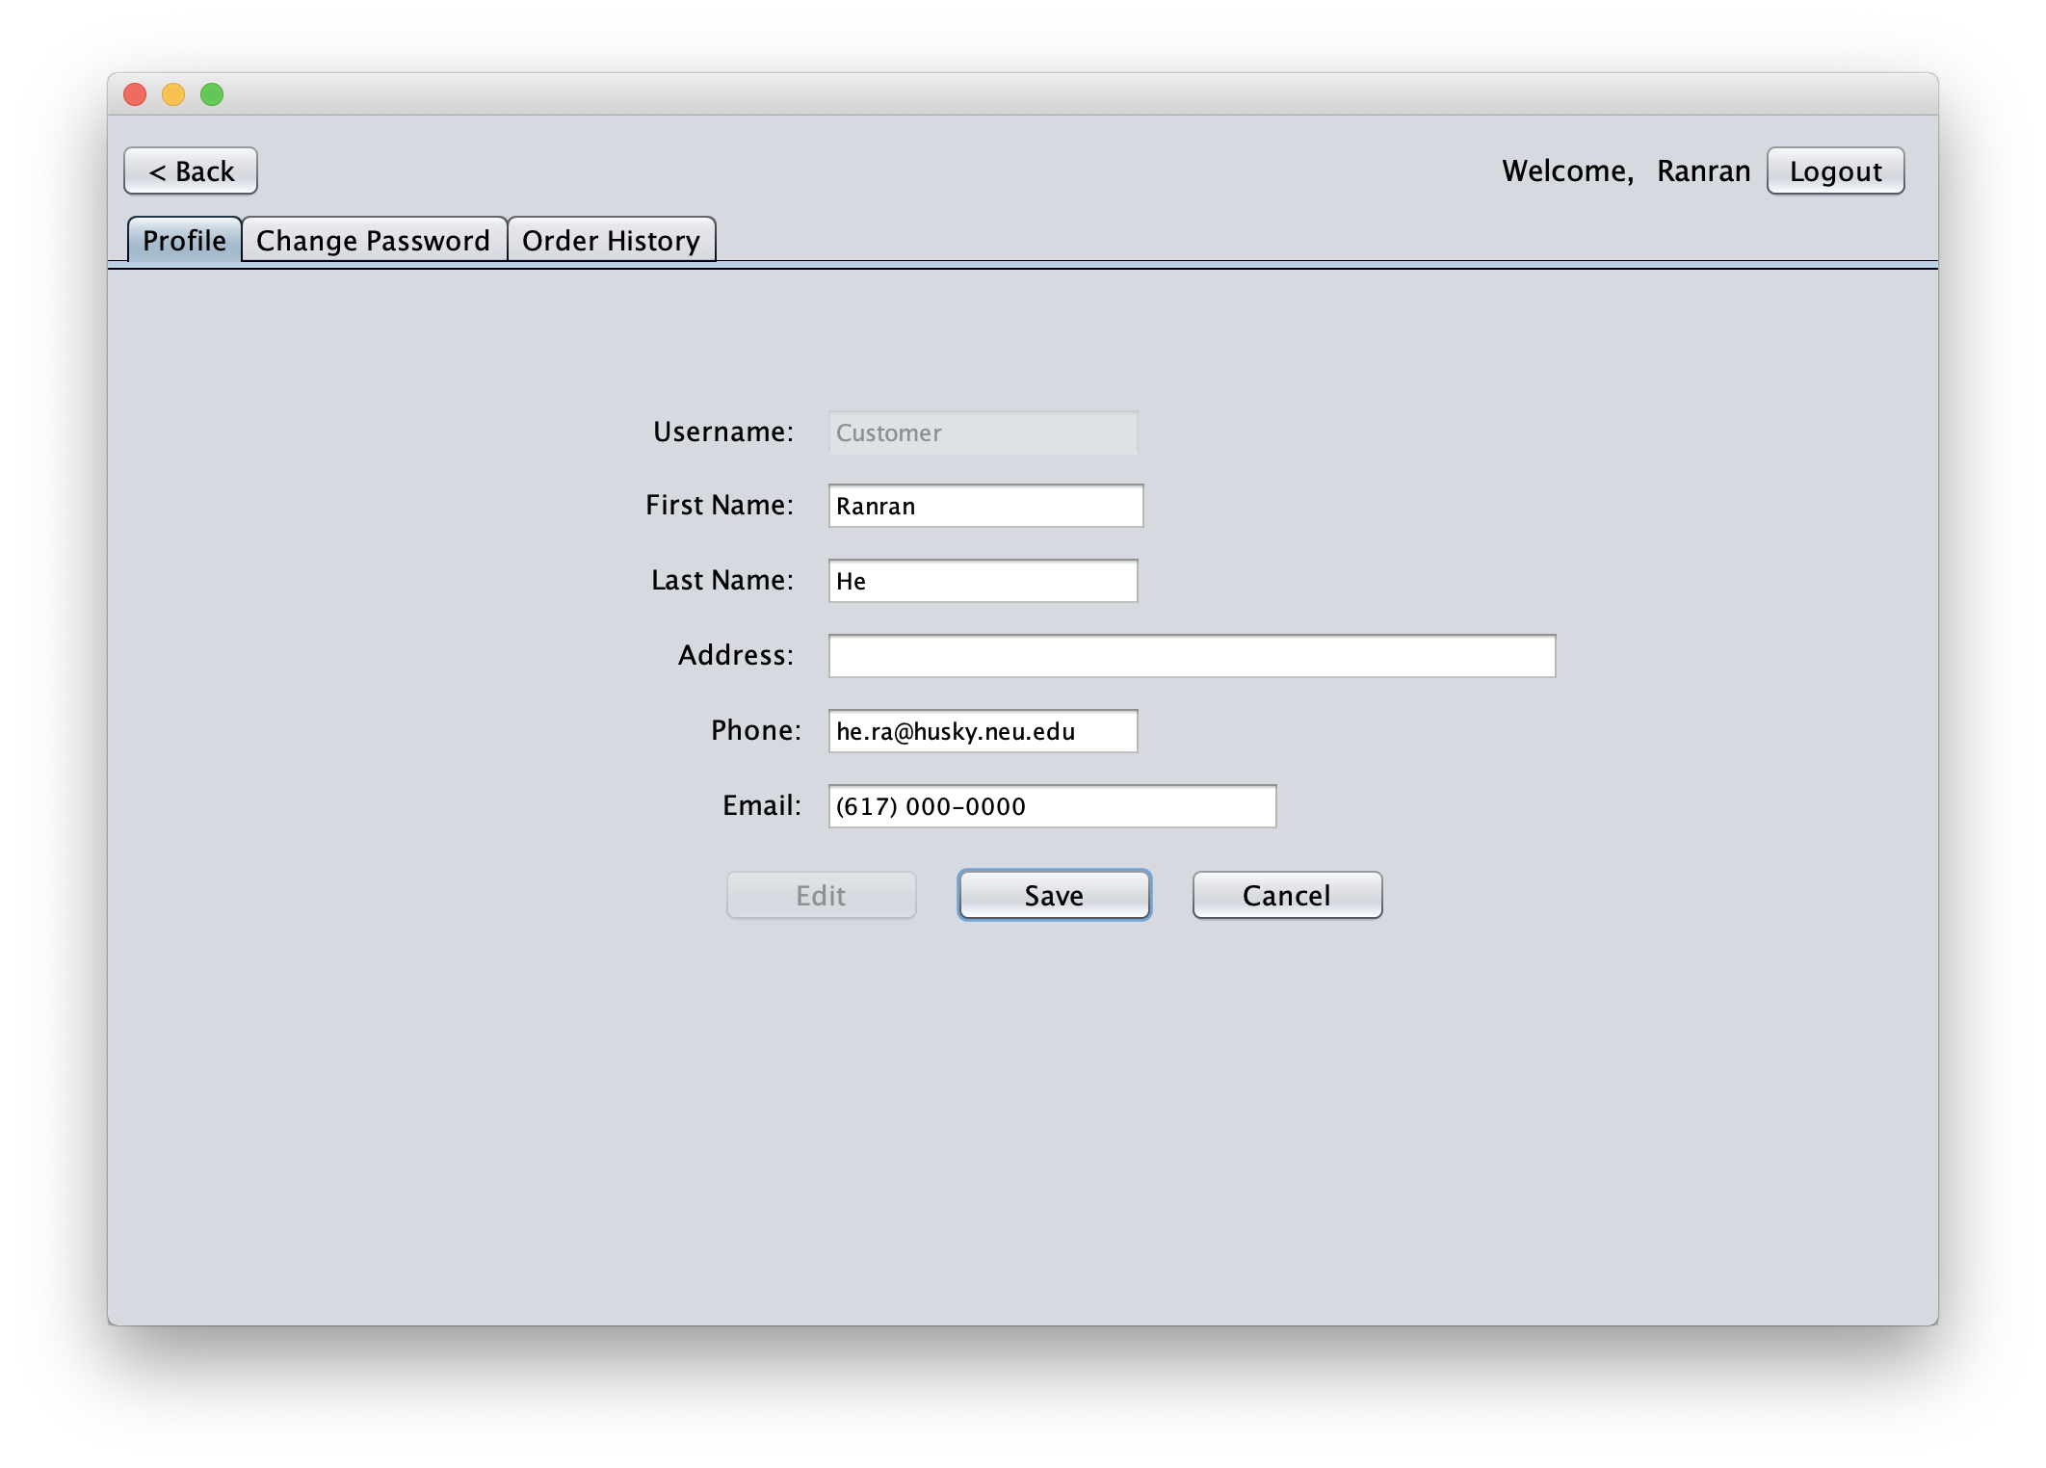
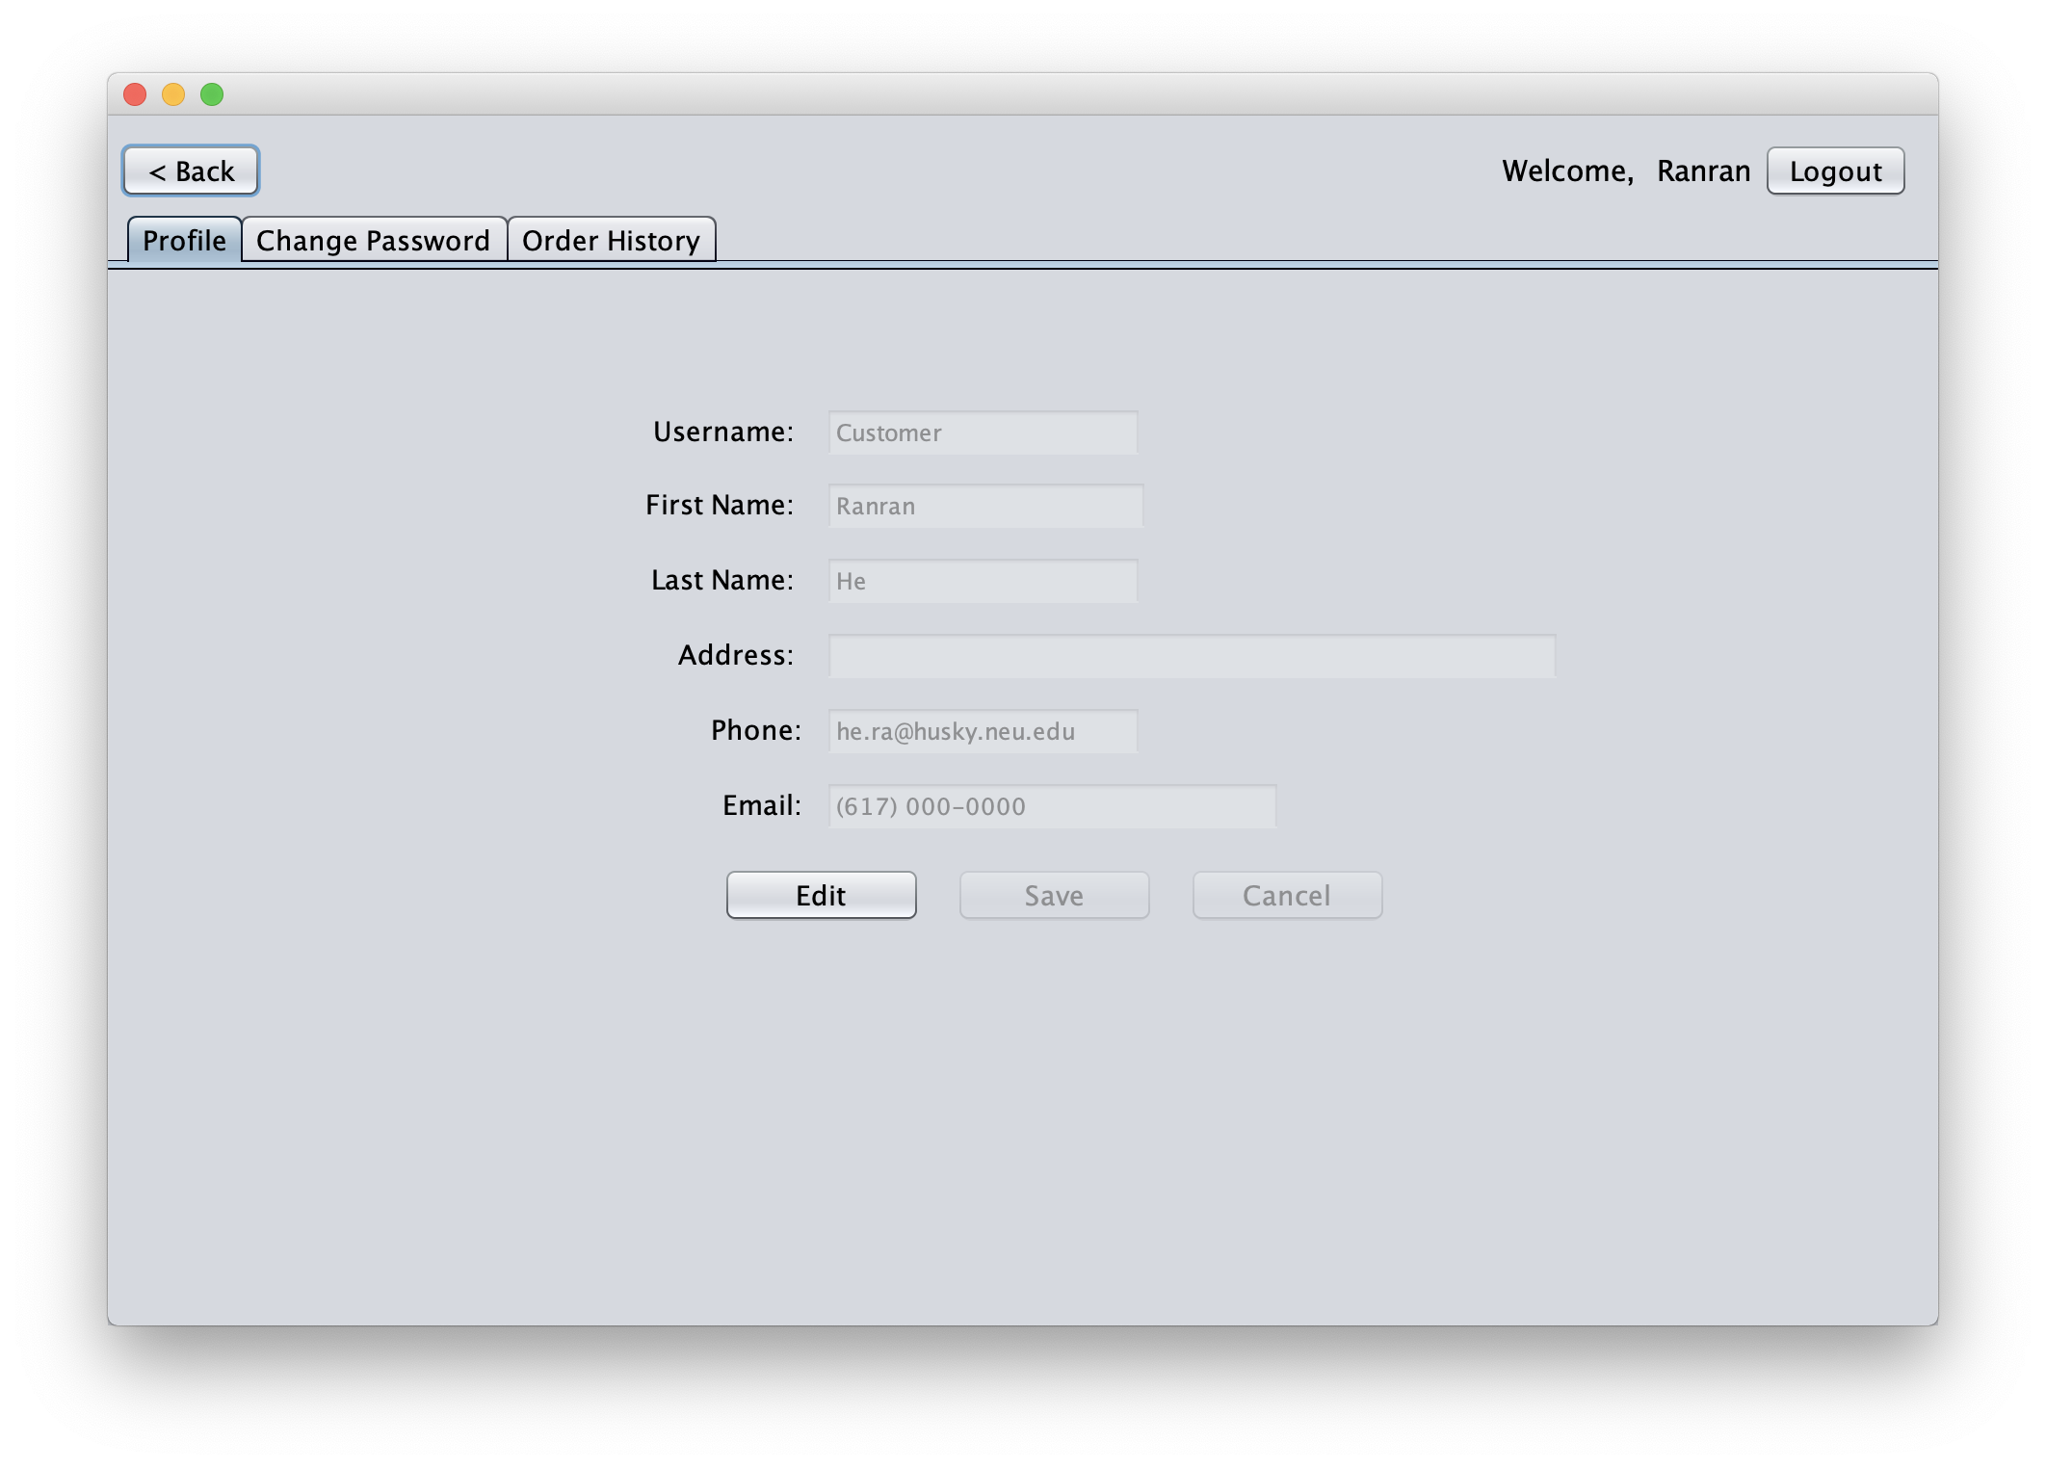
DEMO – Customer Profile

Slide 22
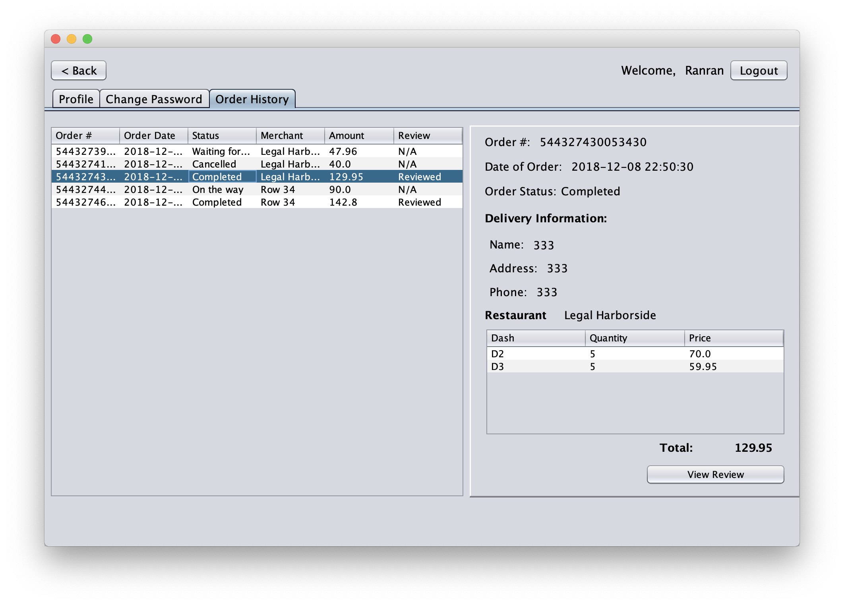
DEMO – Order History
Check Order Status.

Slide 23
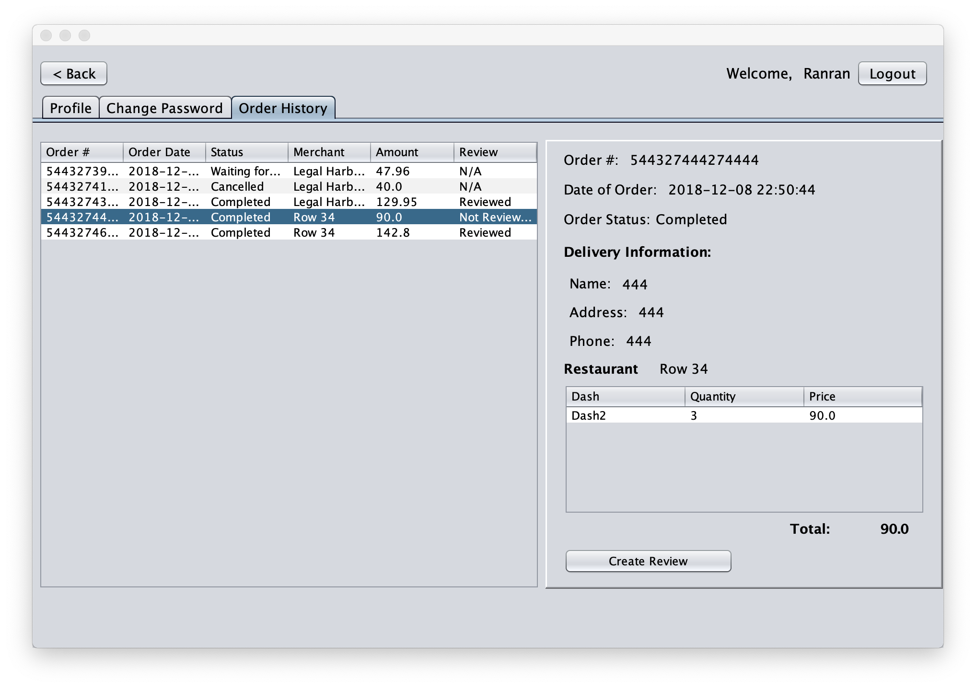
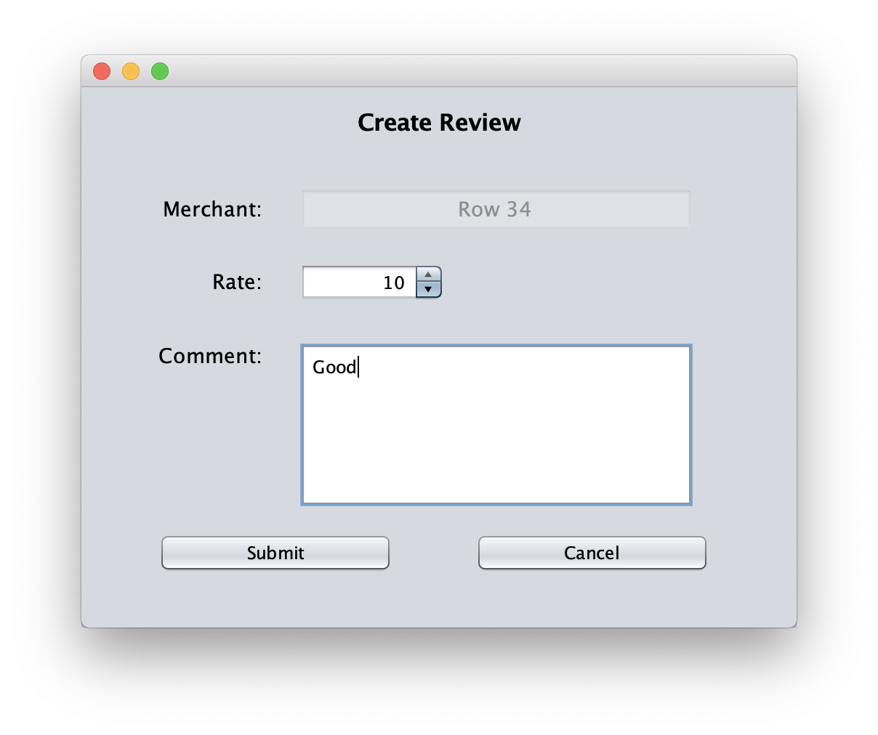
DEMO – Write Review

Slide 24
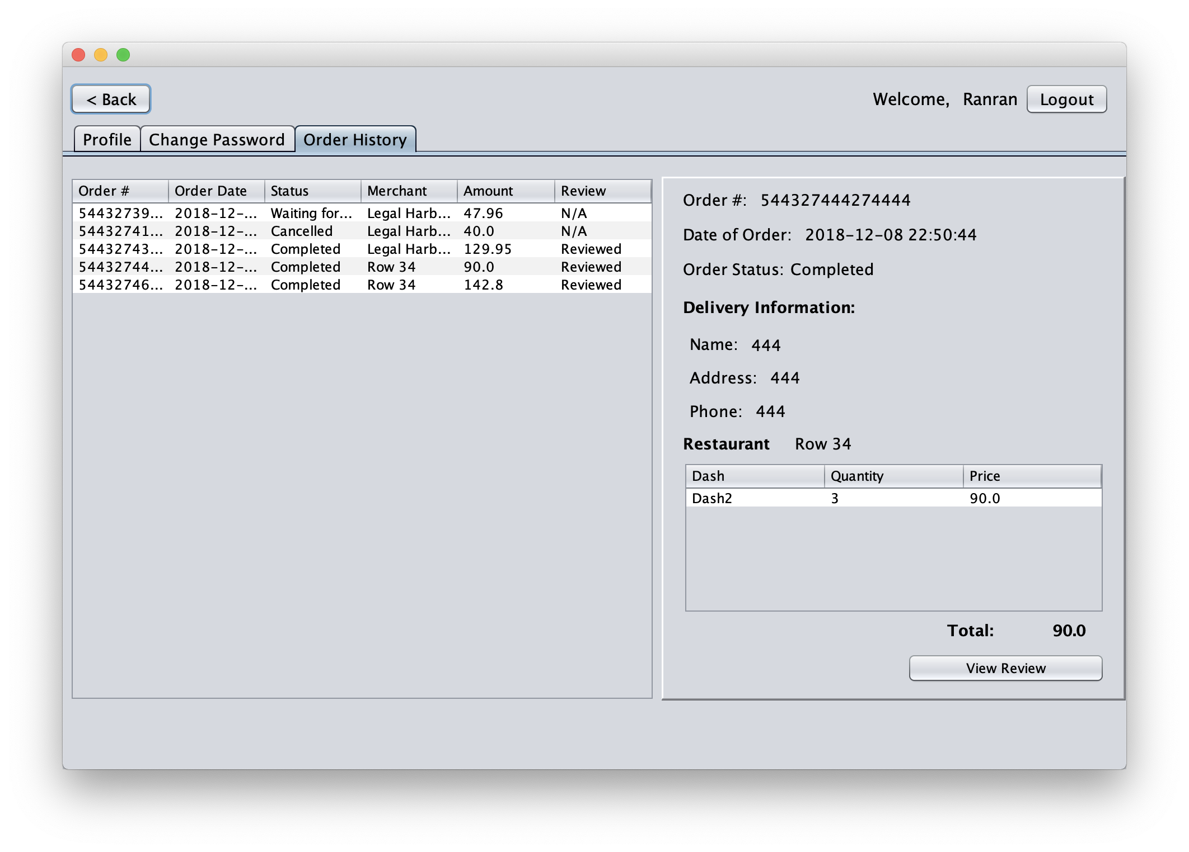
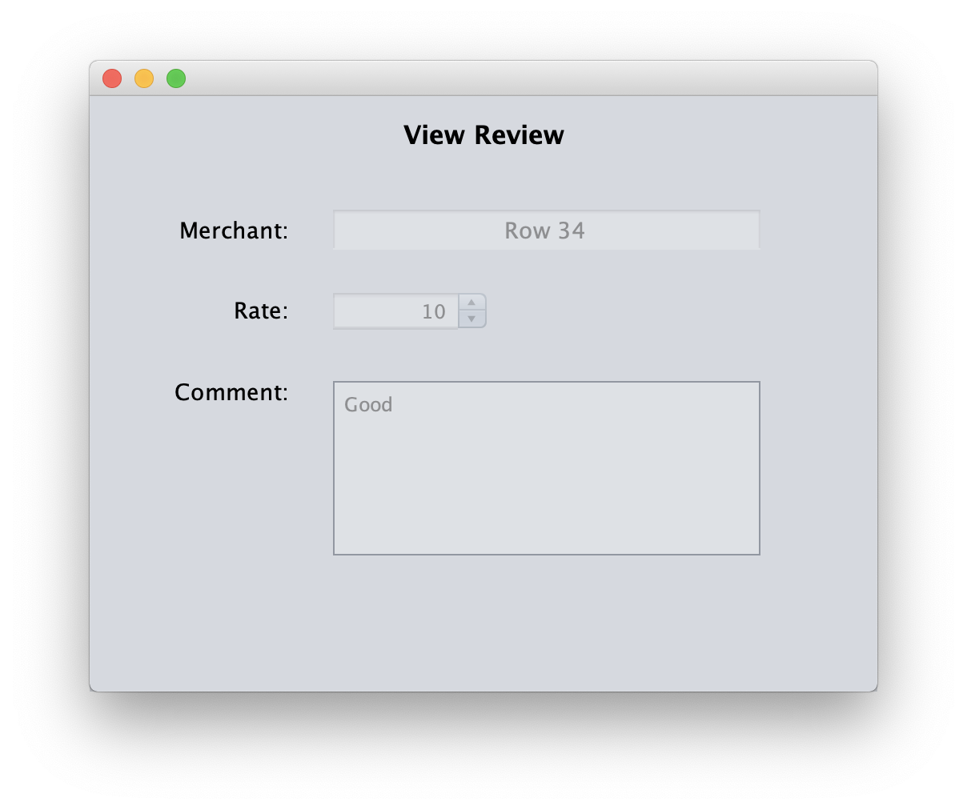
DEMO – View Review

Slide 25
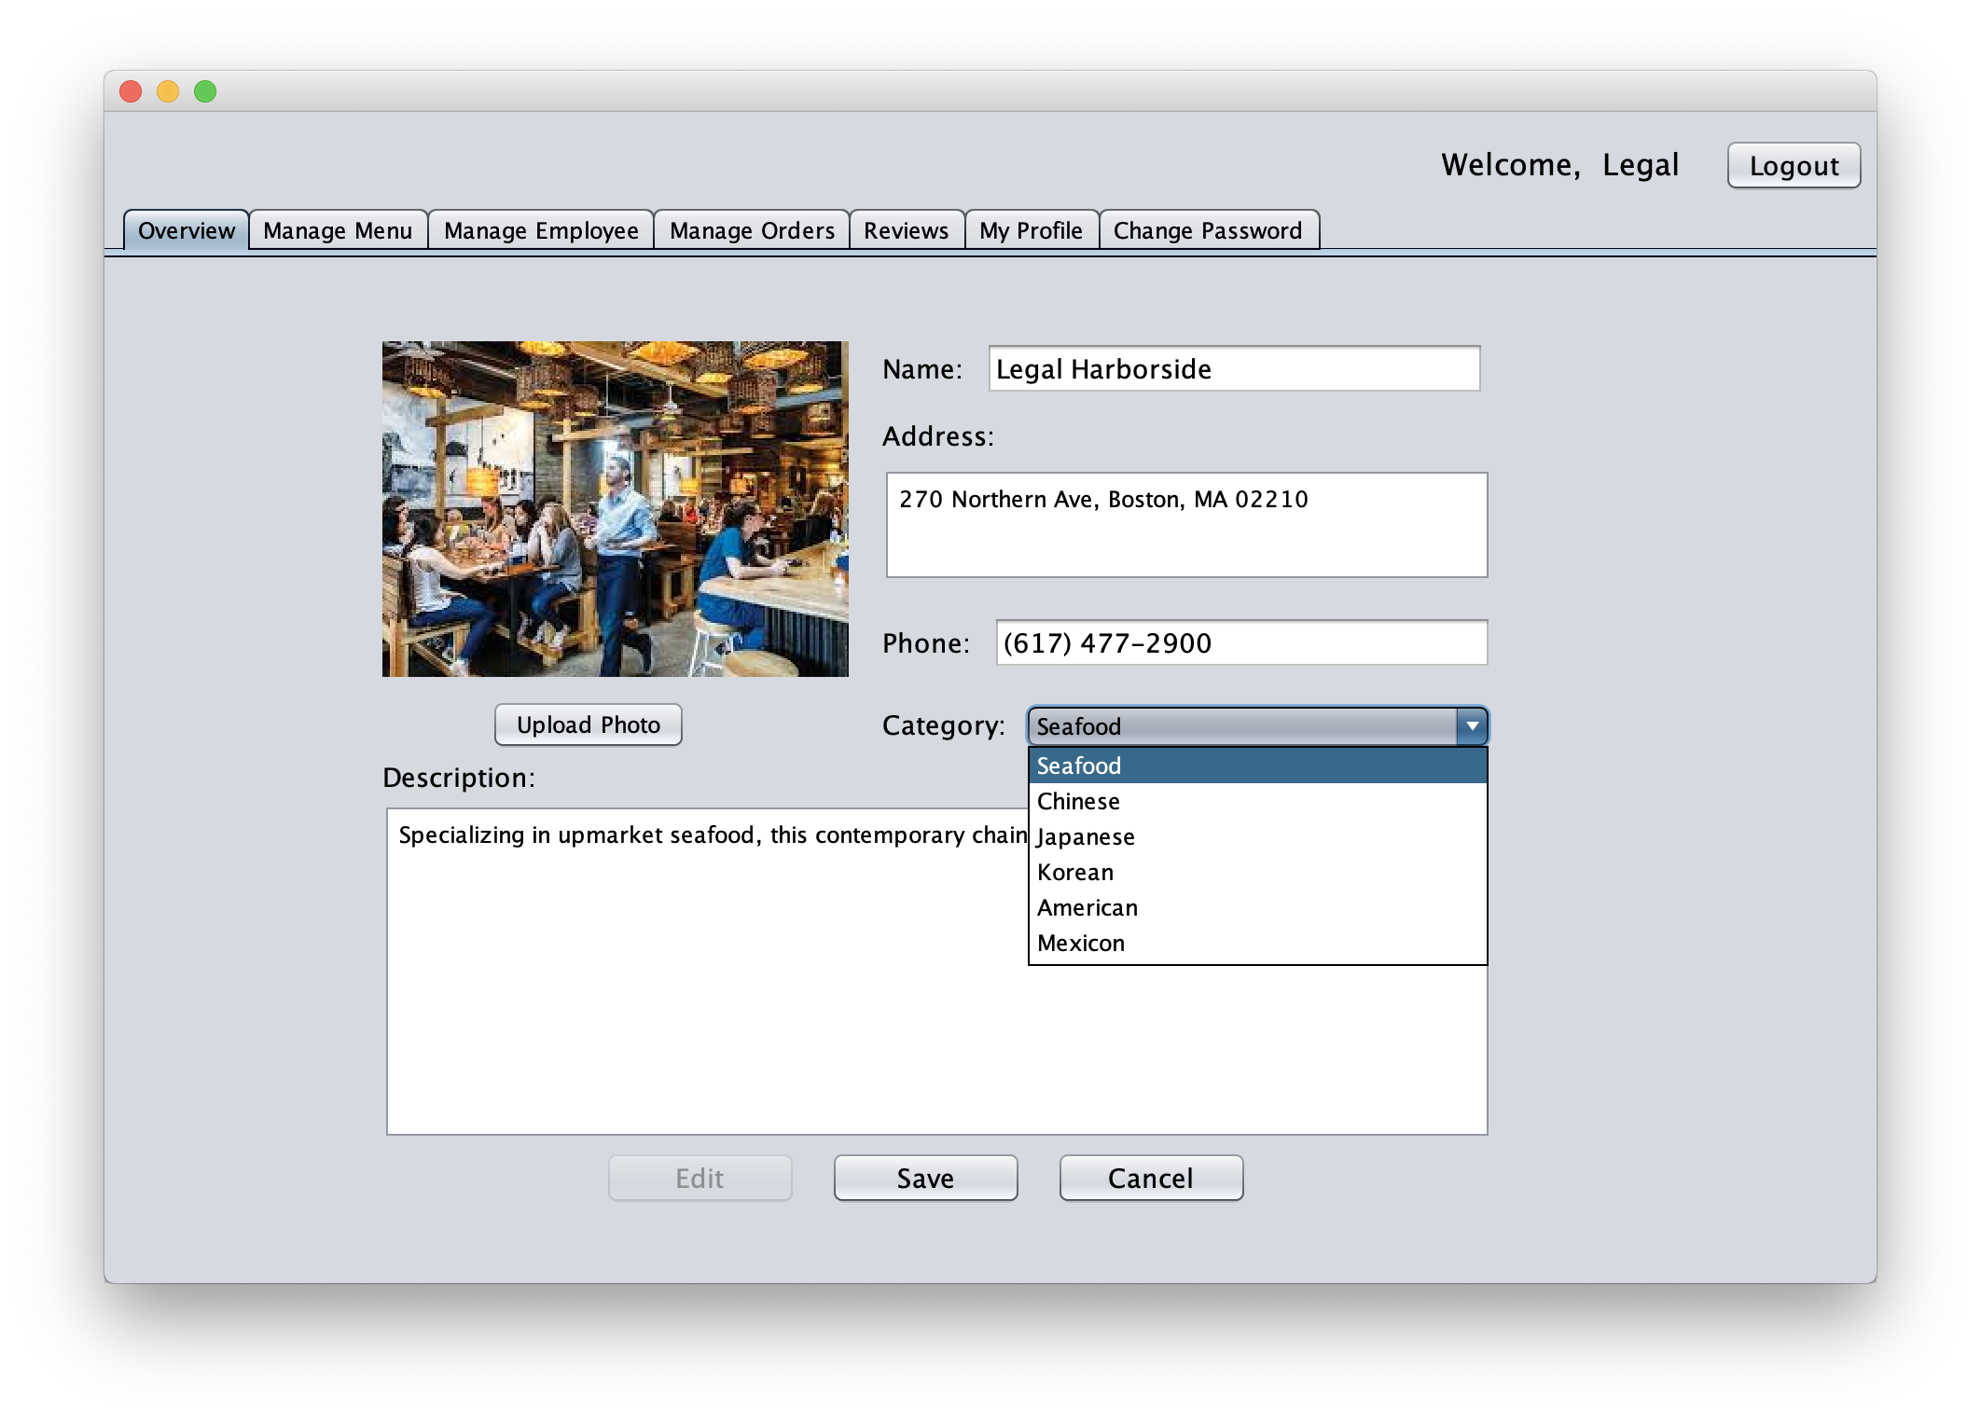
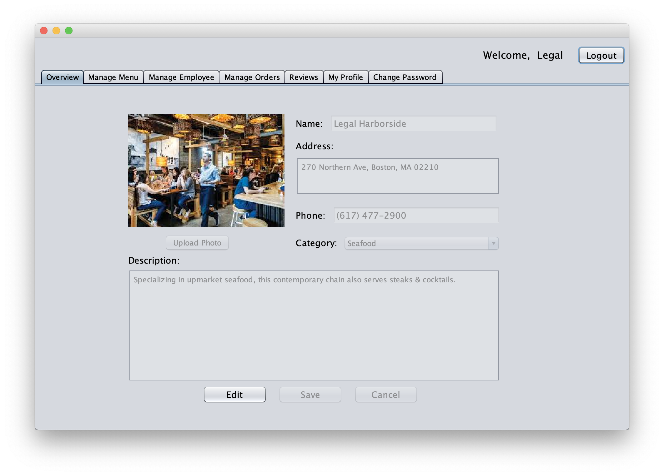
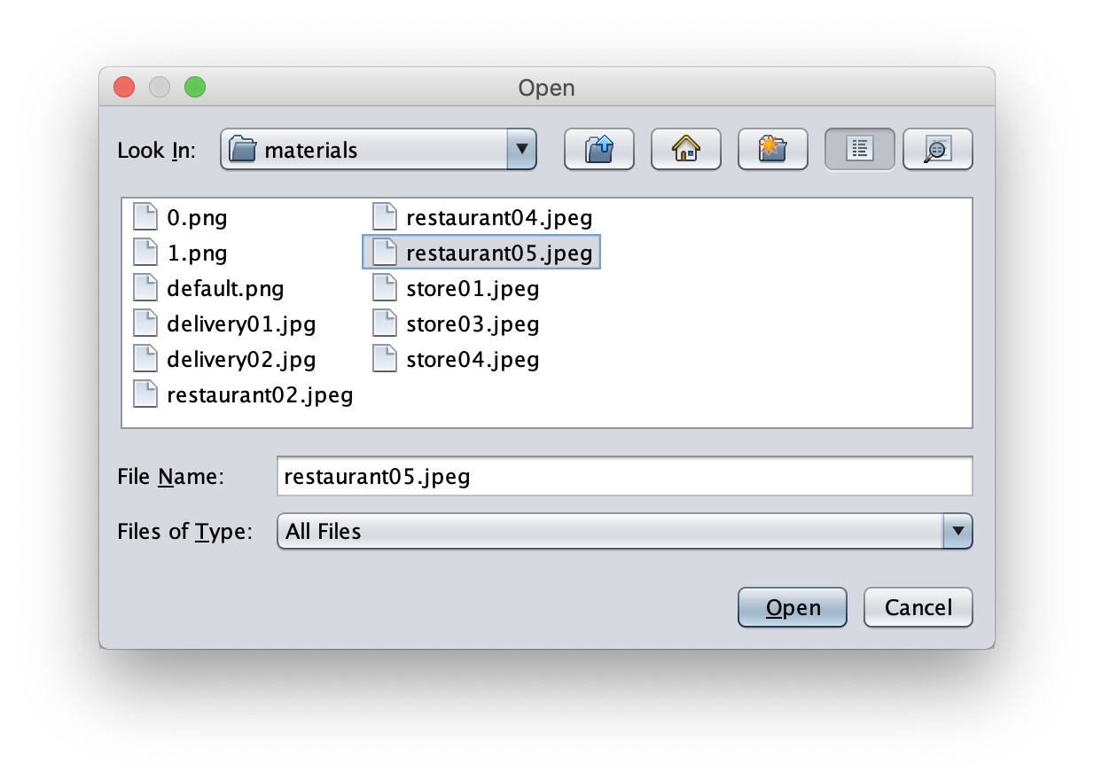
DEMO – Restaurant/Store Manager Main Page

Slide 26
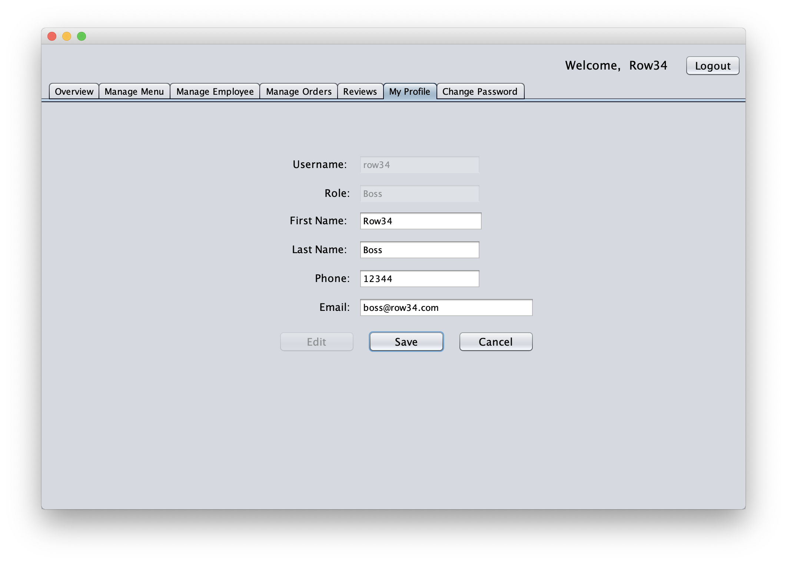
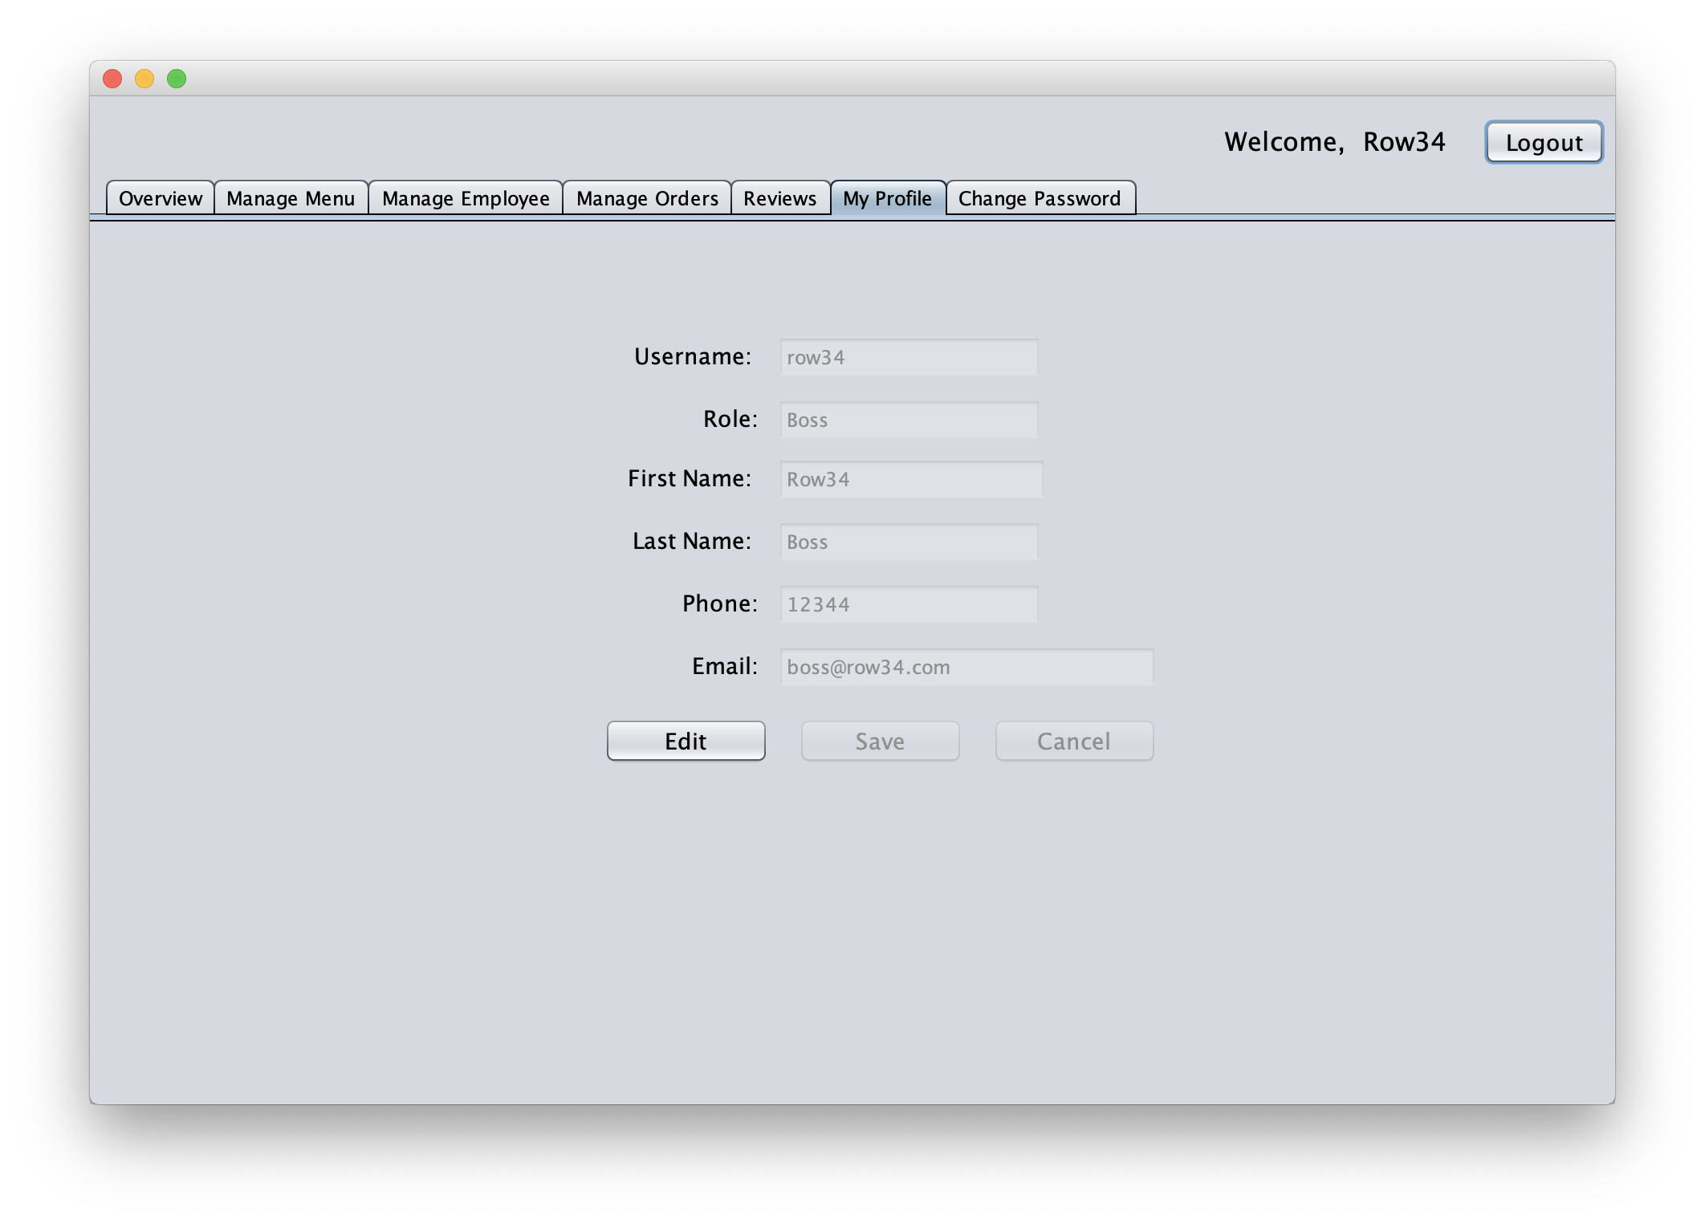
DEMO – Restaurant/Store Employee Profile

Slide 27
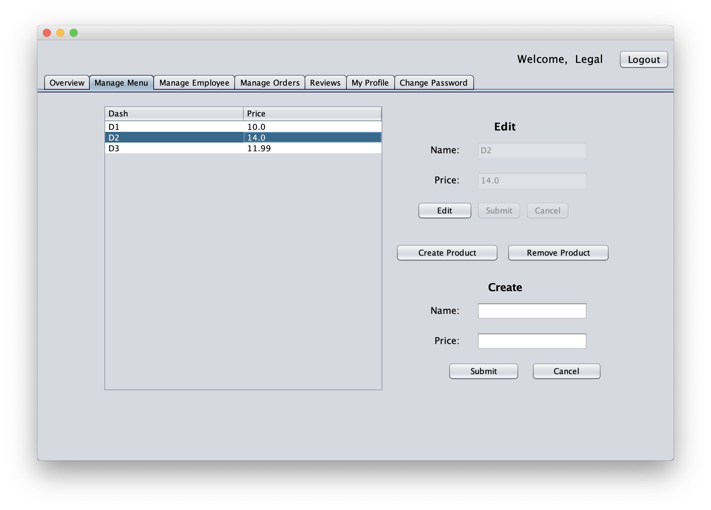
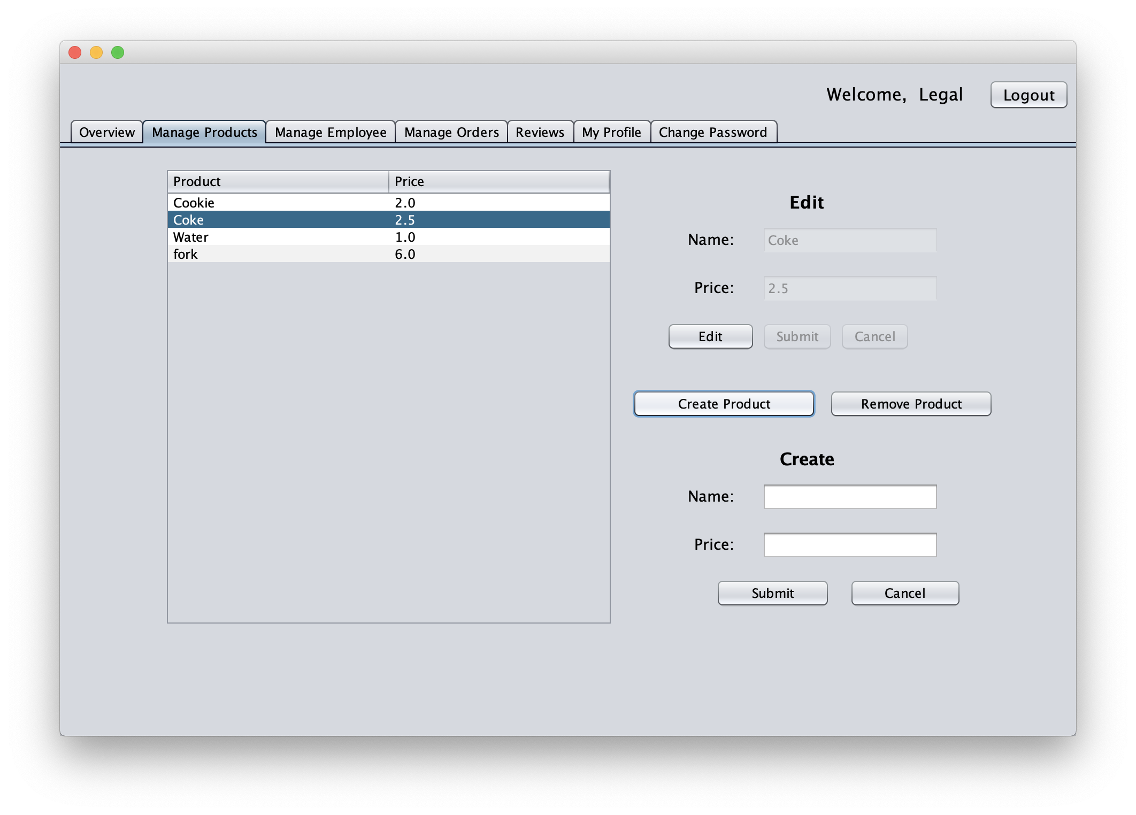
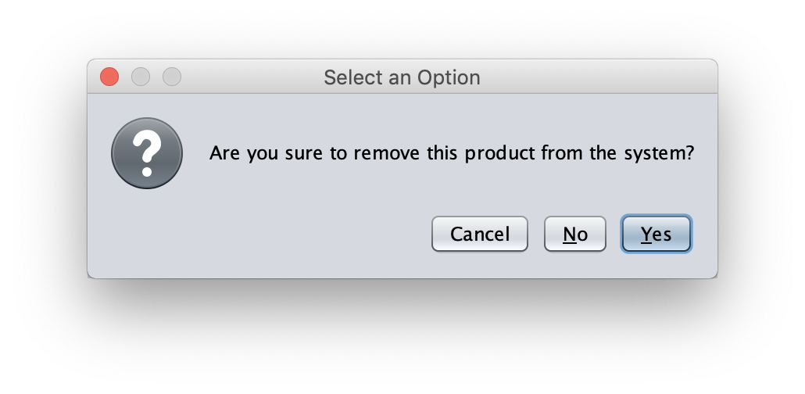
DEMO – Manage menu/product

Slide 28
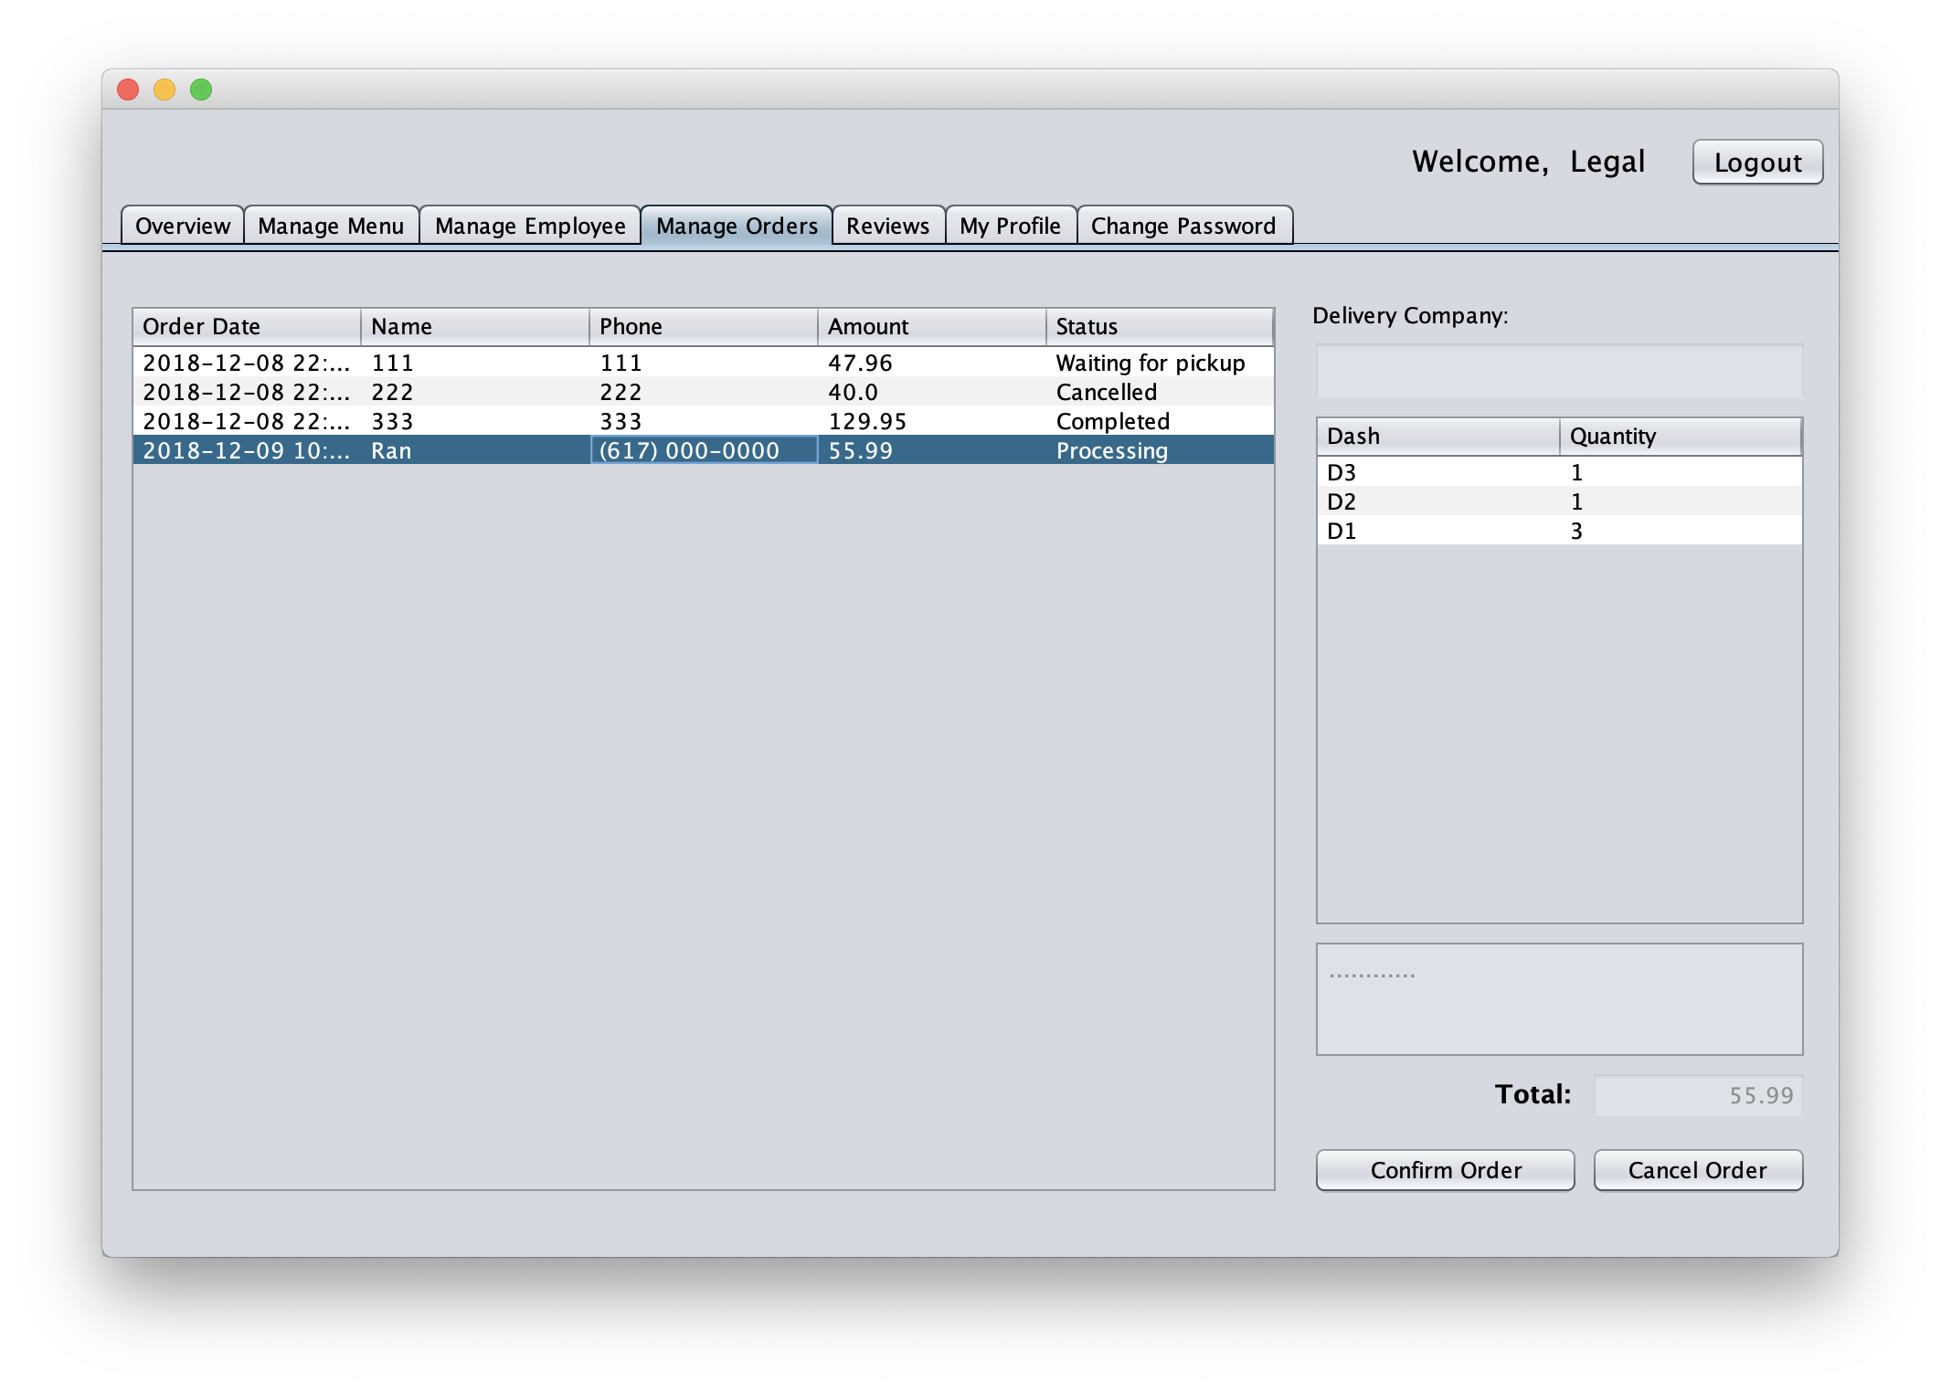
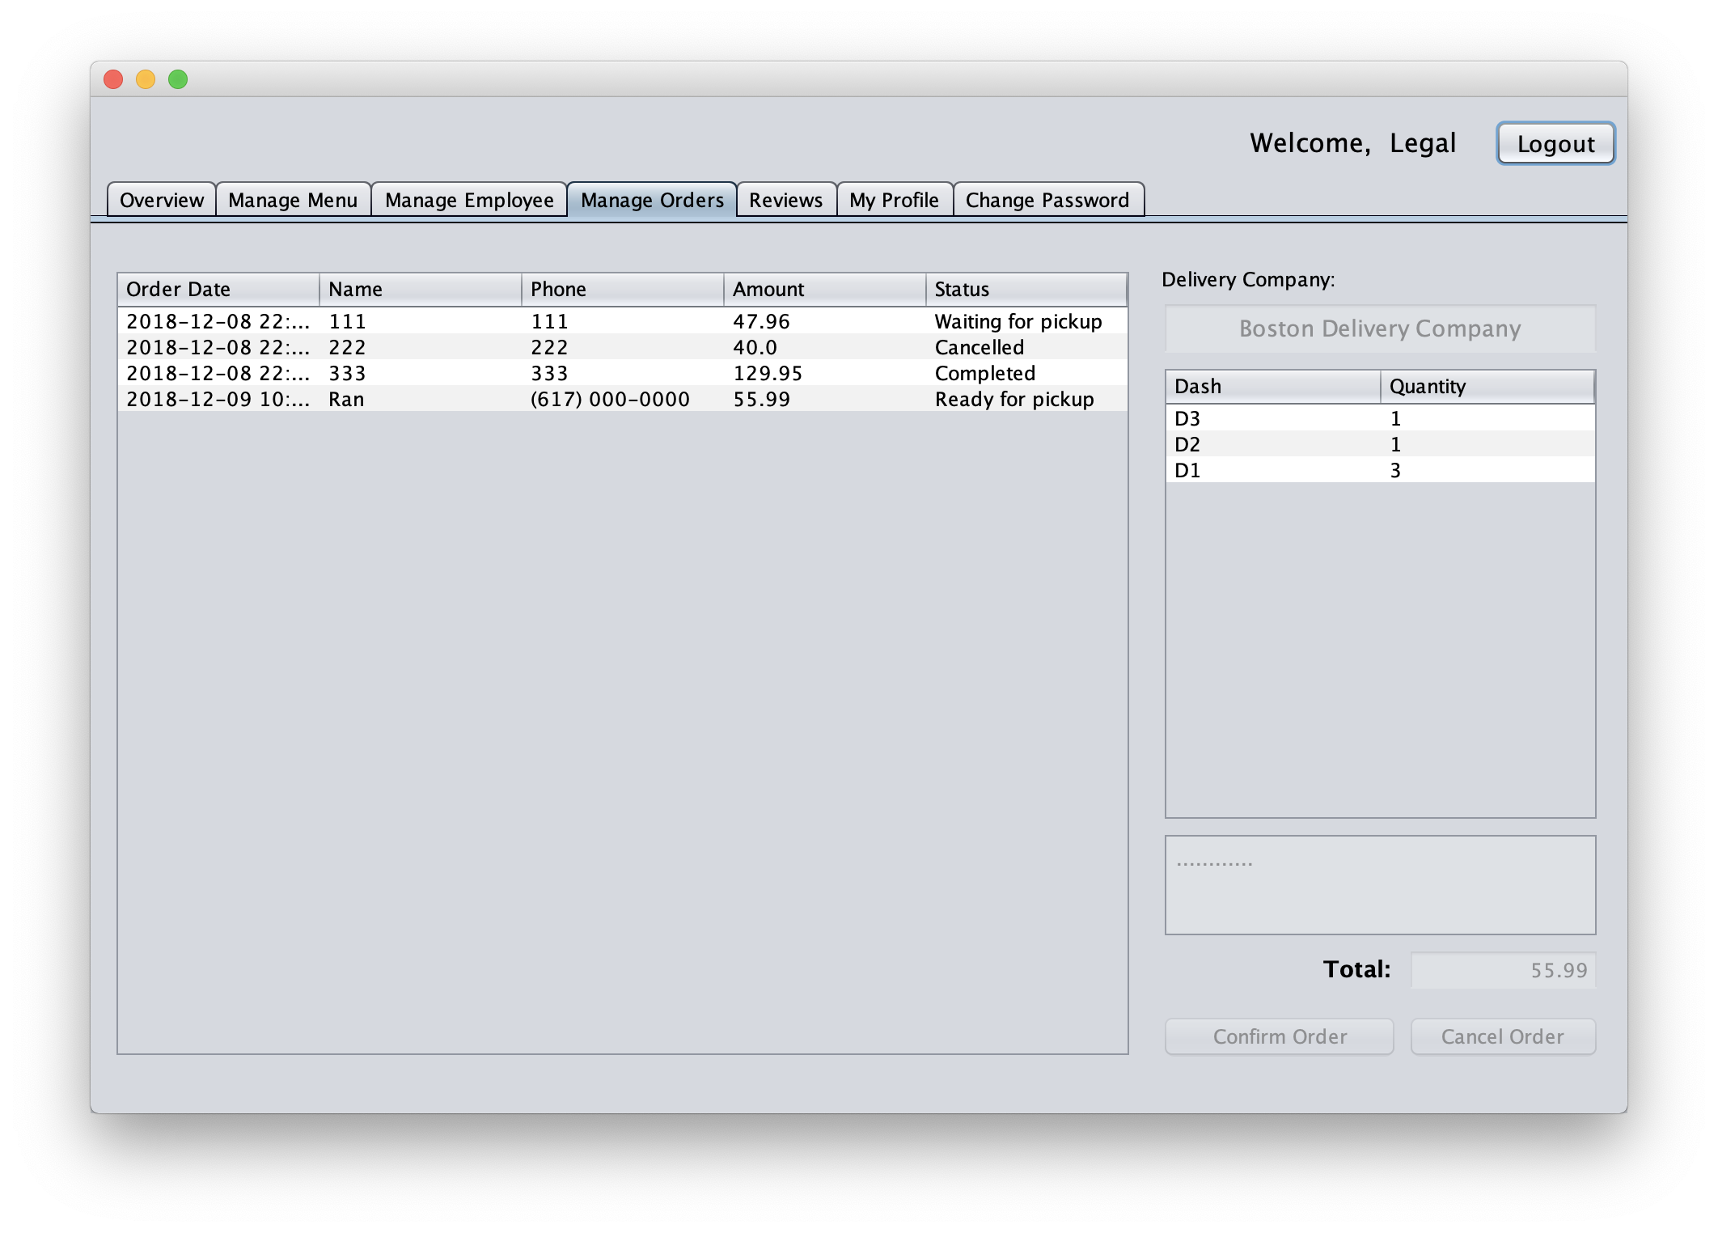
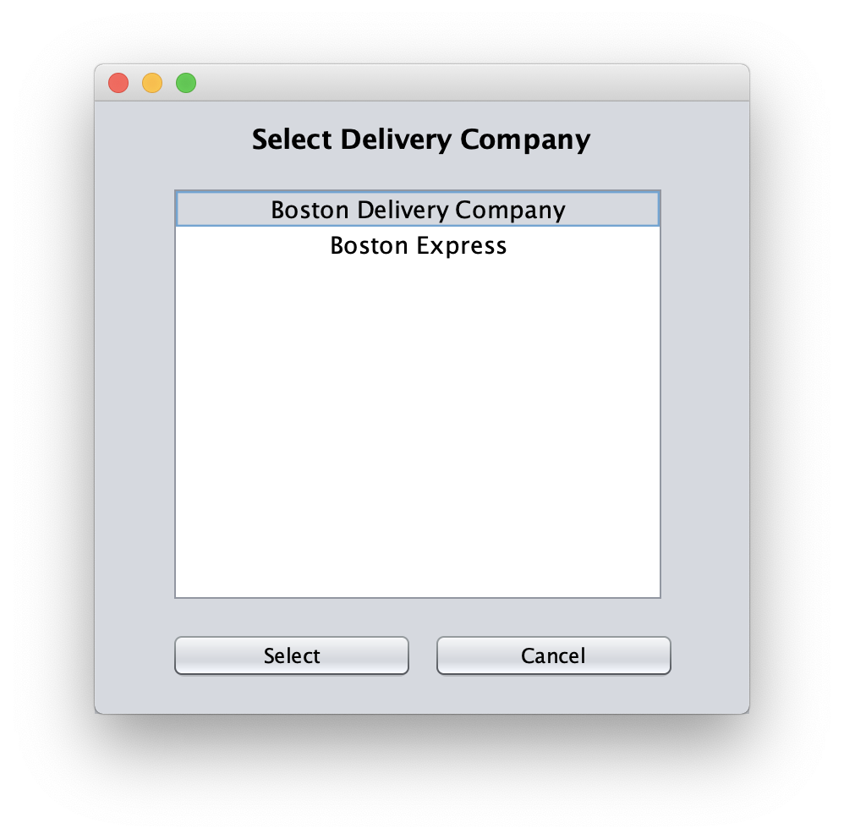
DEMO – Manage Order

Slide 29
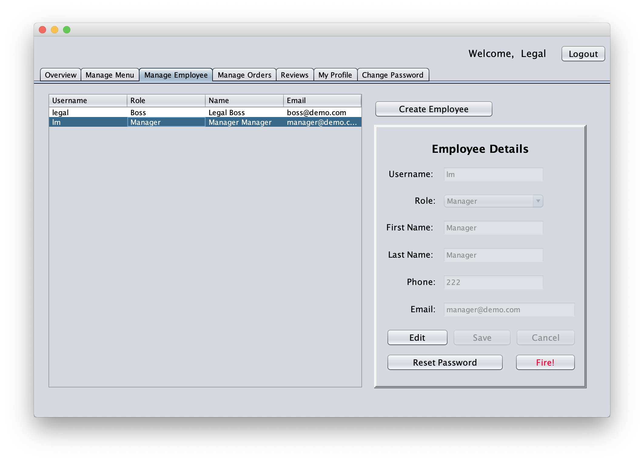
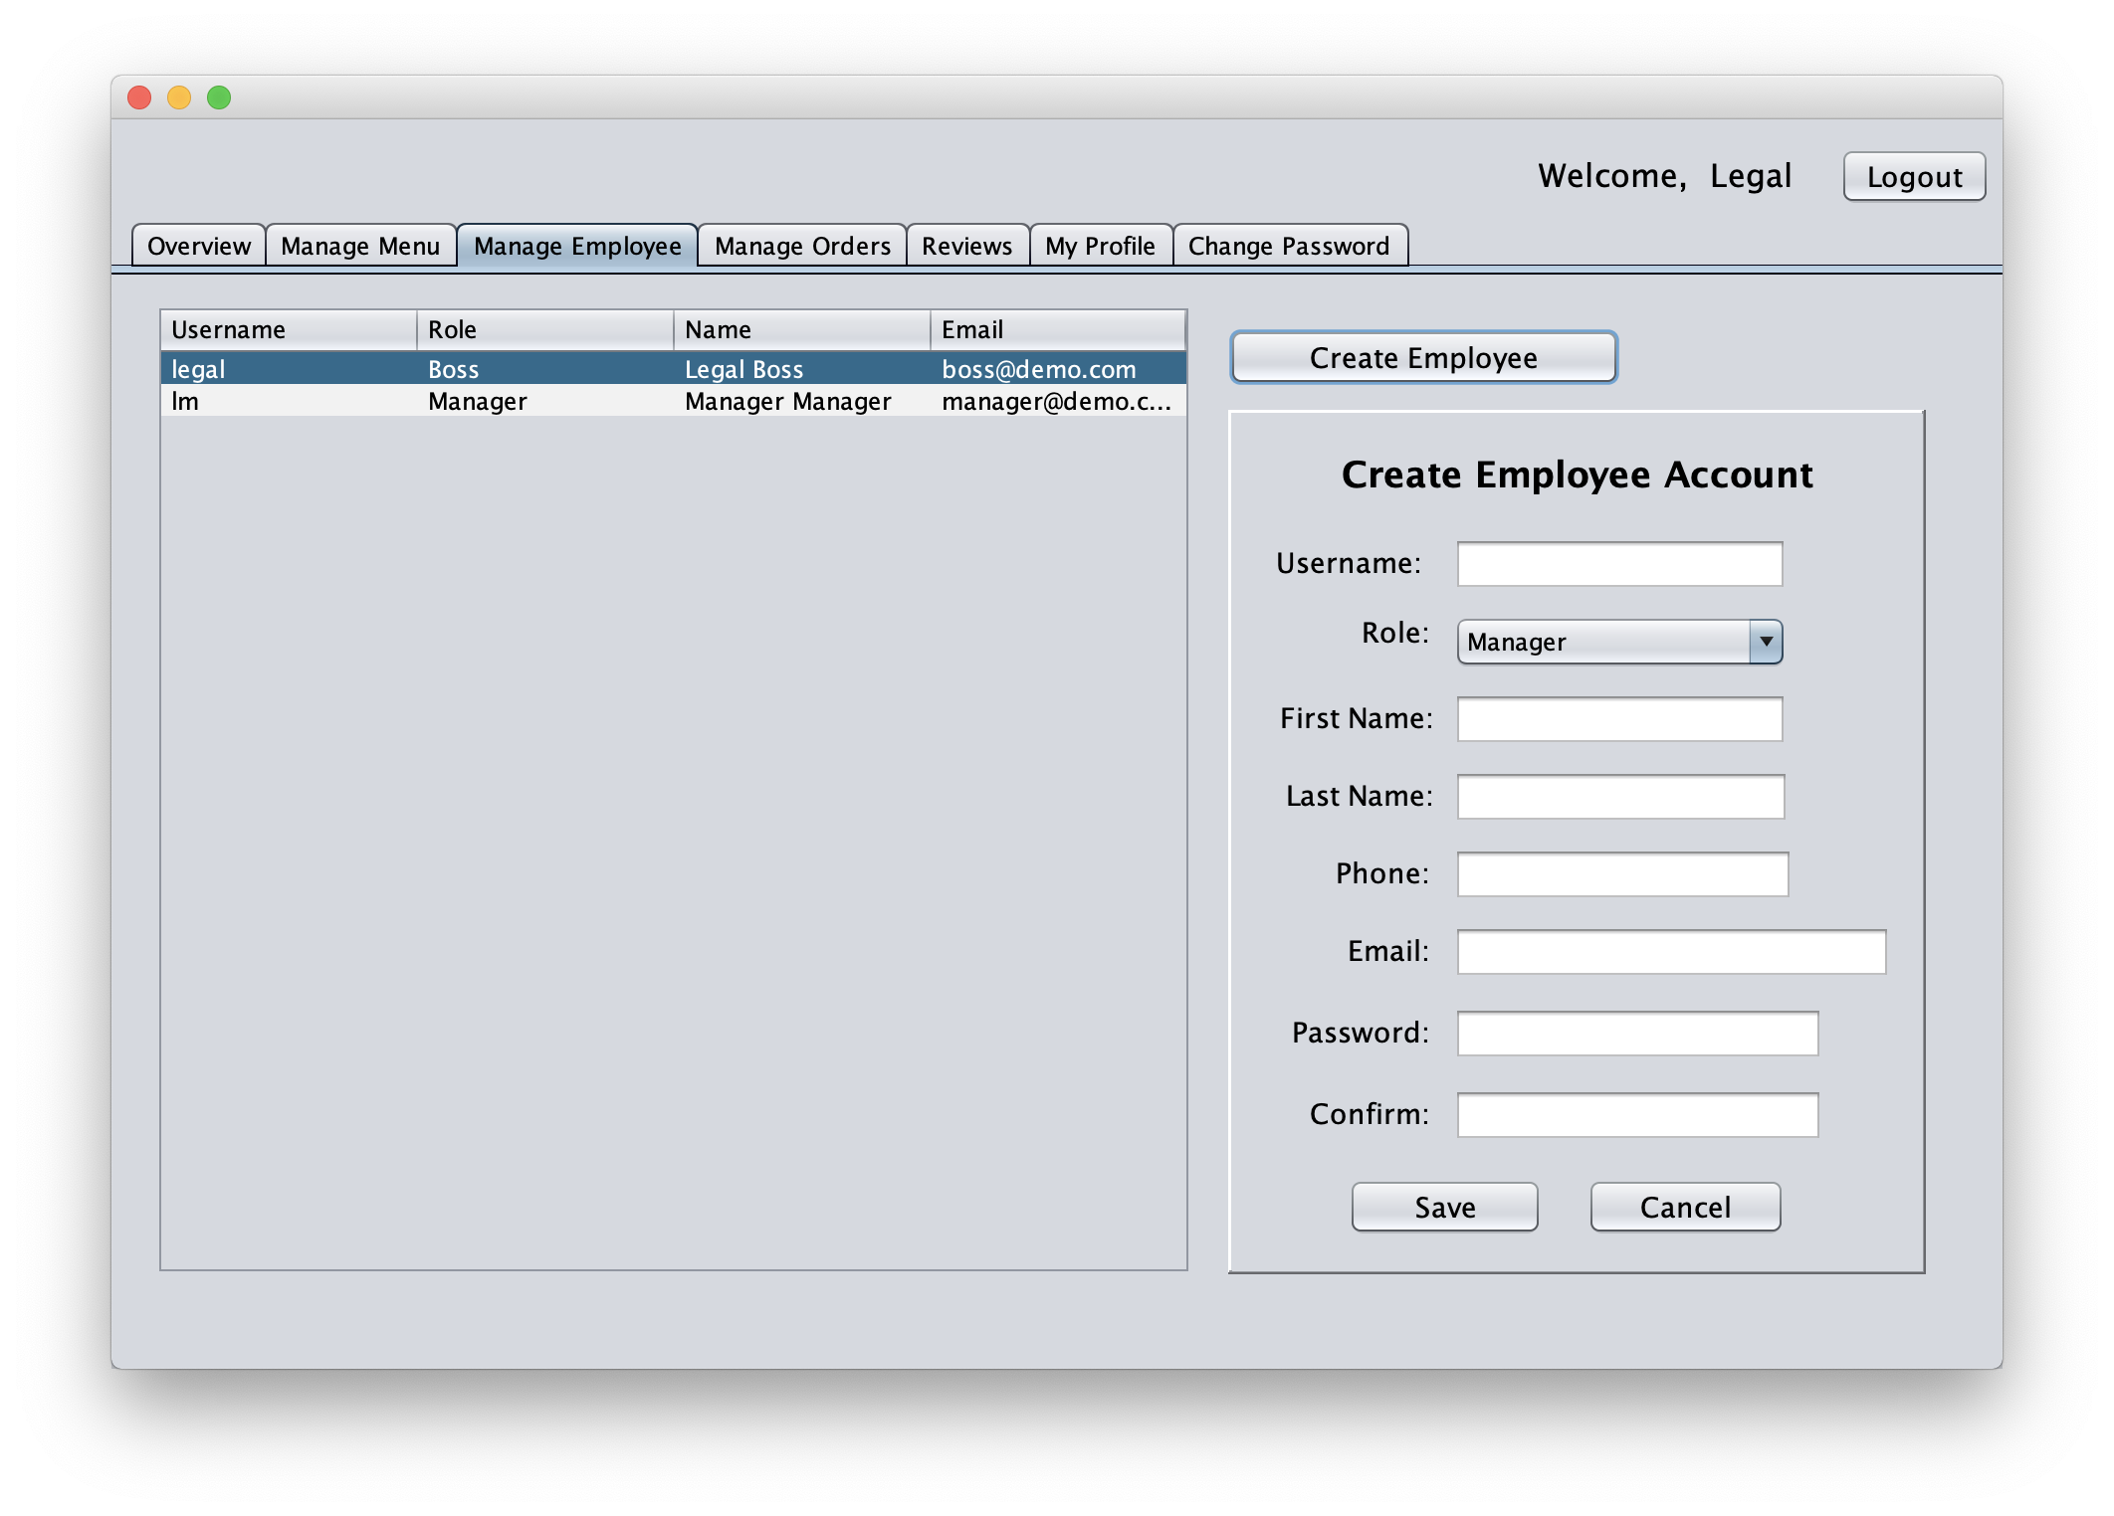
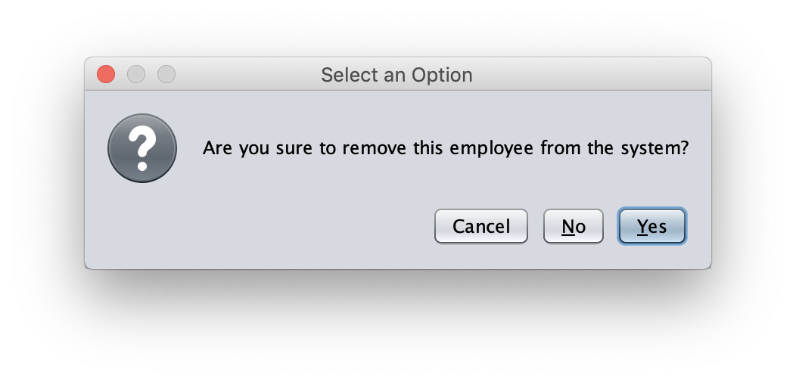
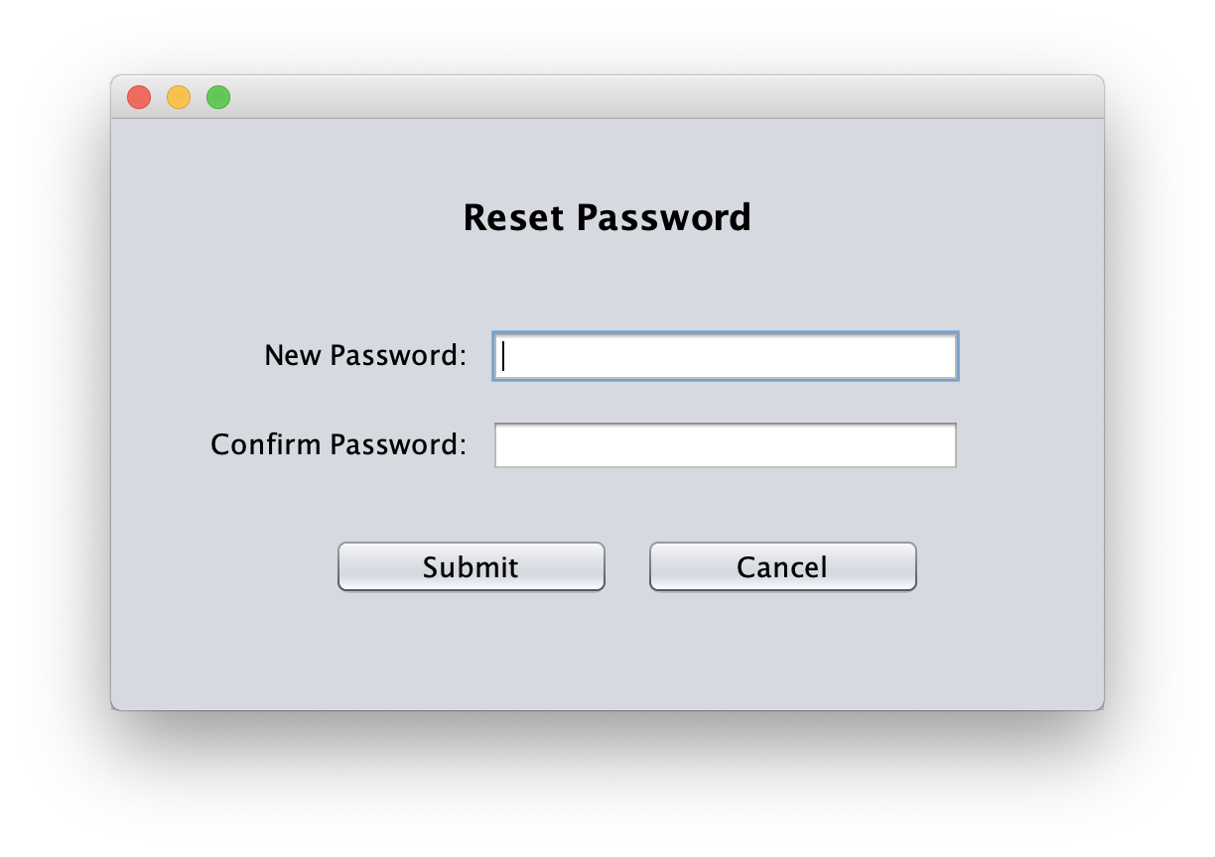
DEMO – Manage Employee

Slide 30
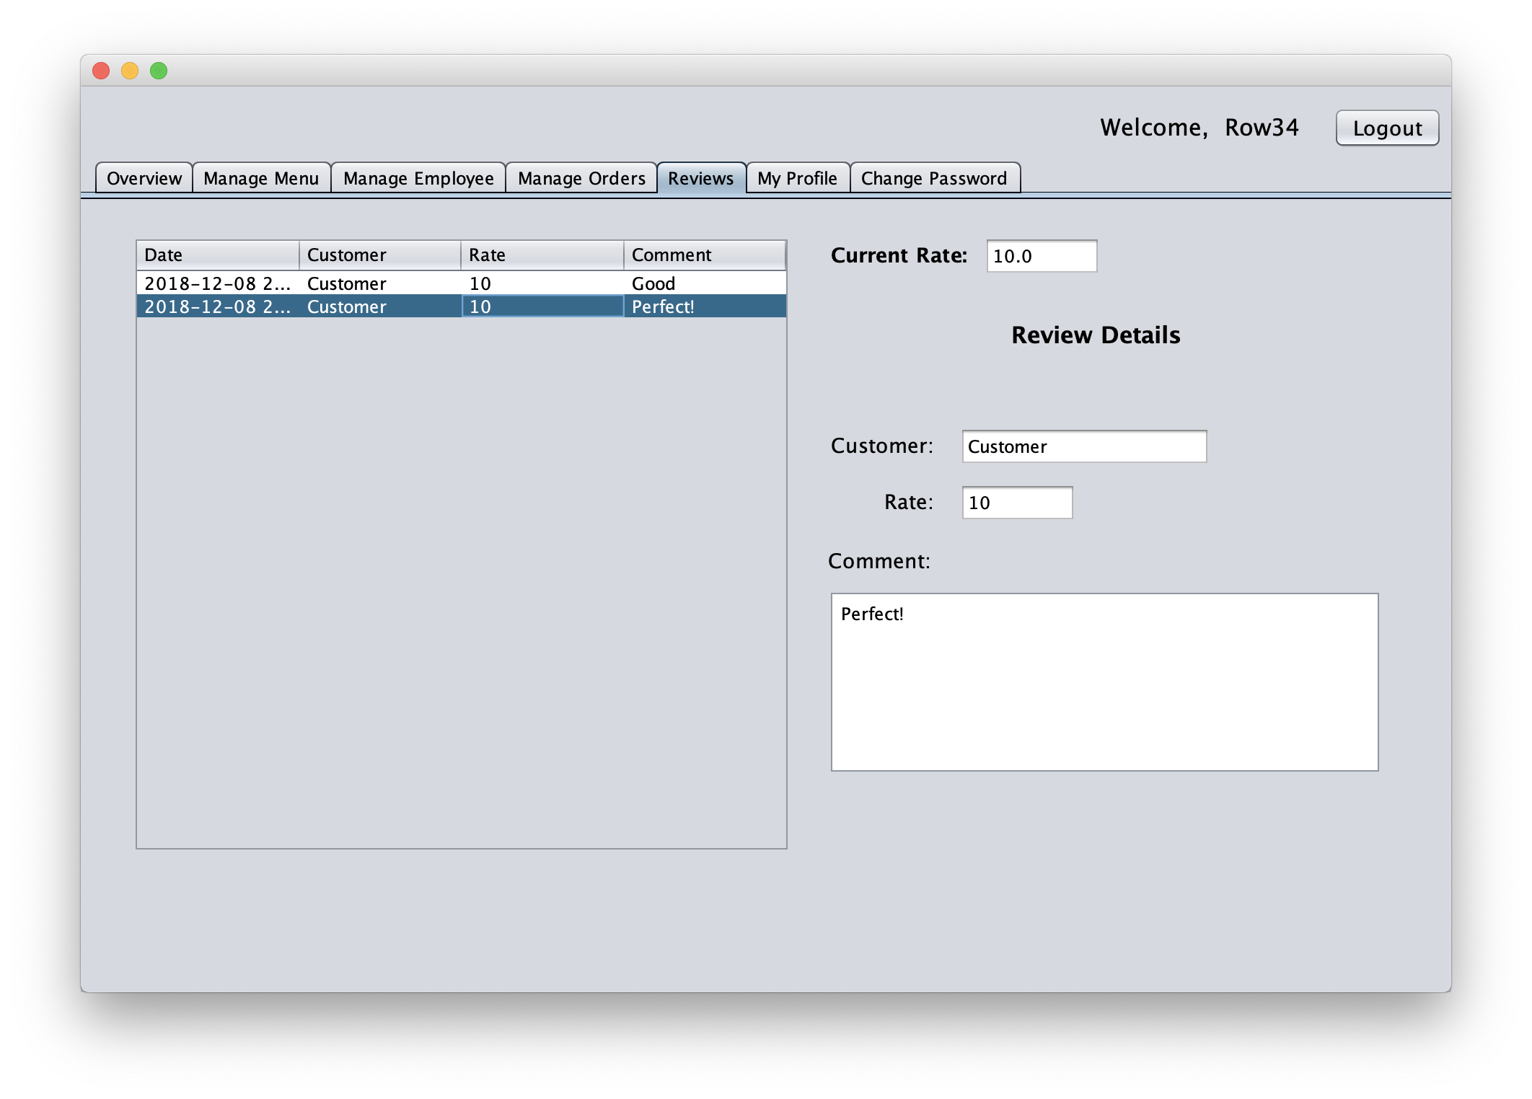
DEMO – View Reviews

Slide 31
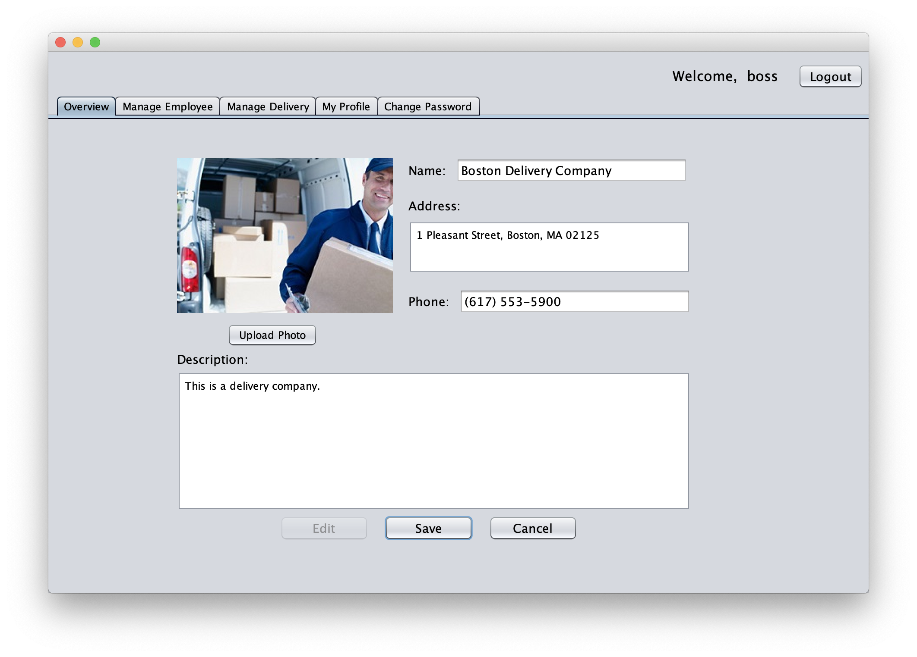
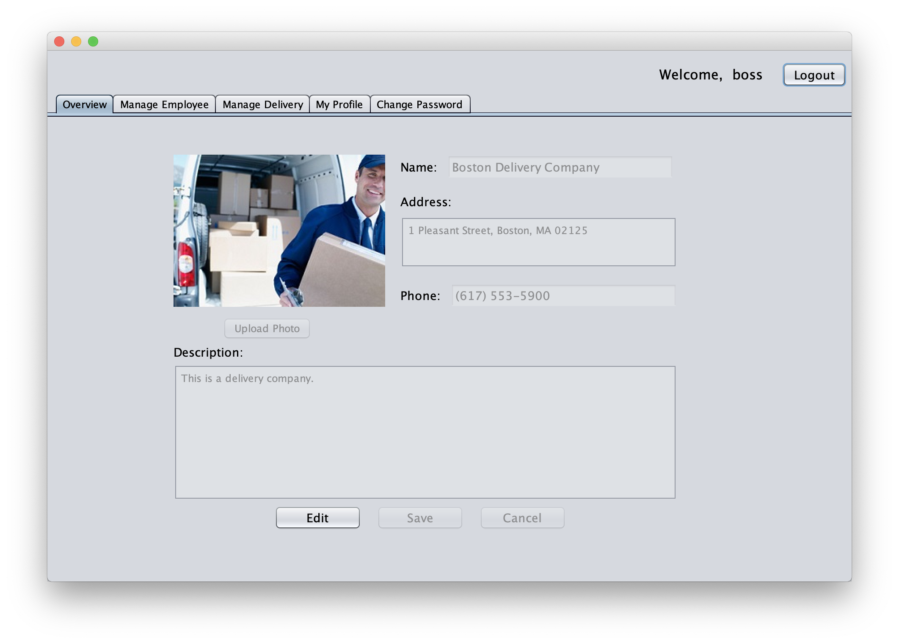
DEMO – Delivery Company Boss/Manager

Slide 32
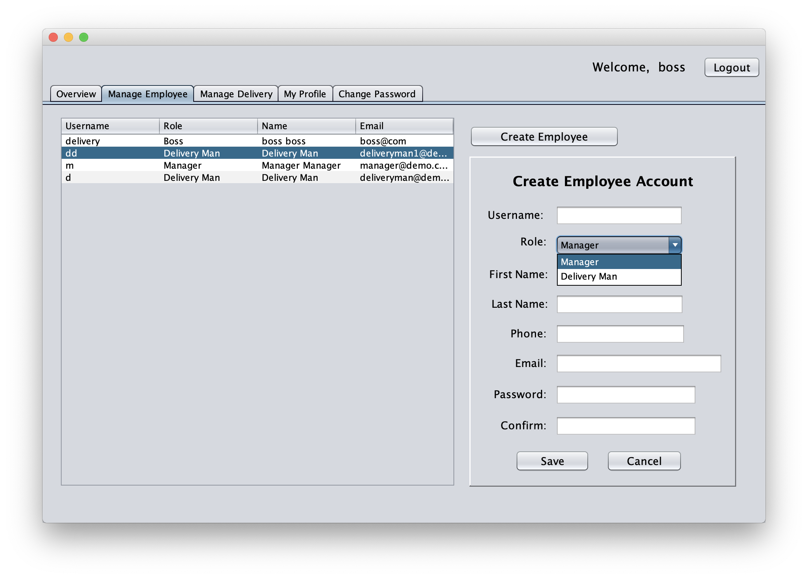
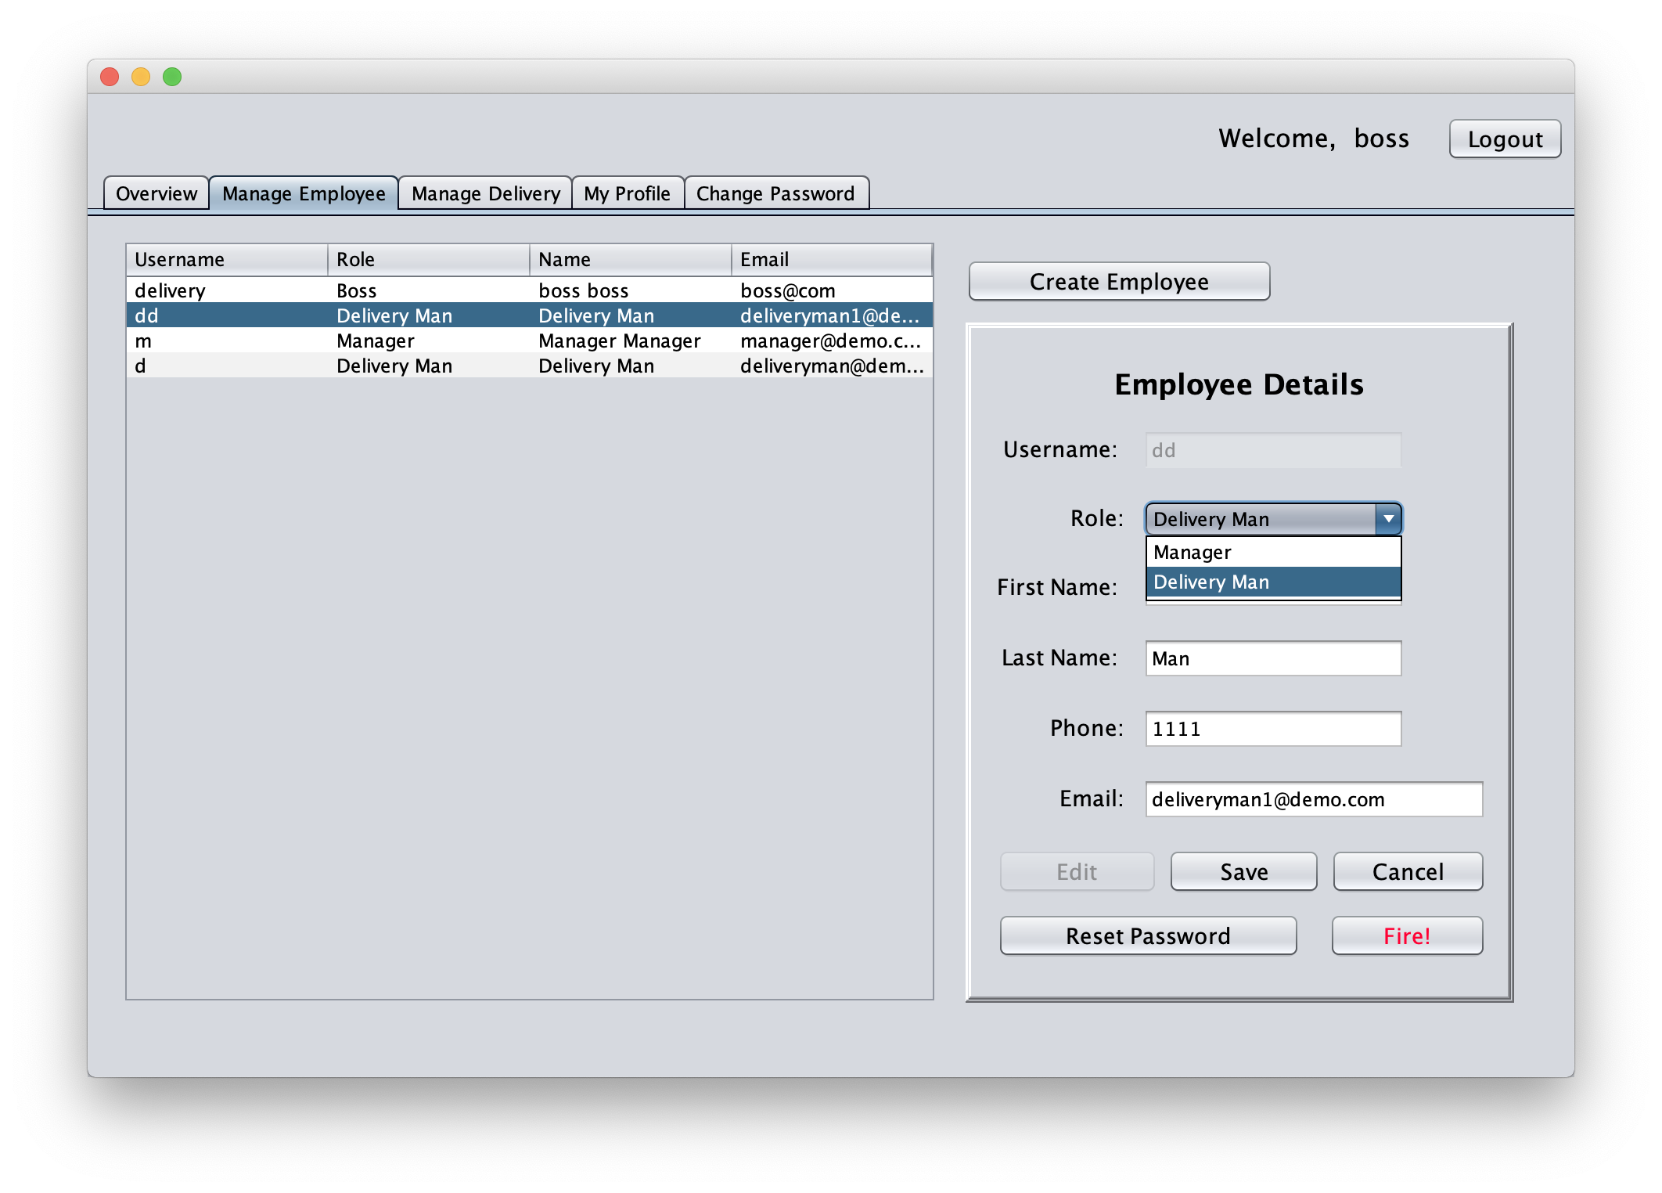

DEMO – Manage Employee

Slide 33
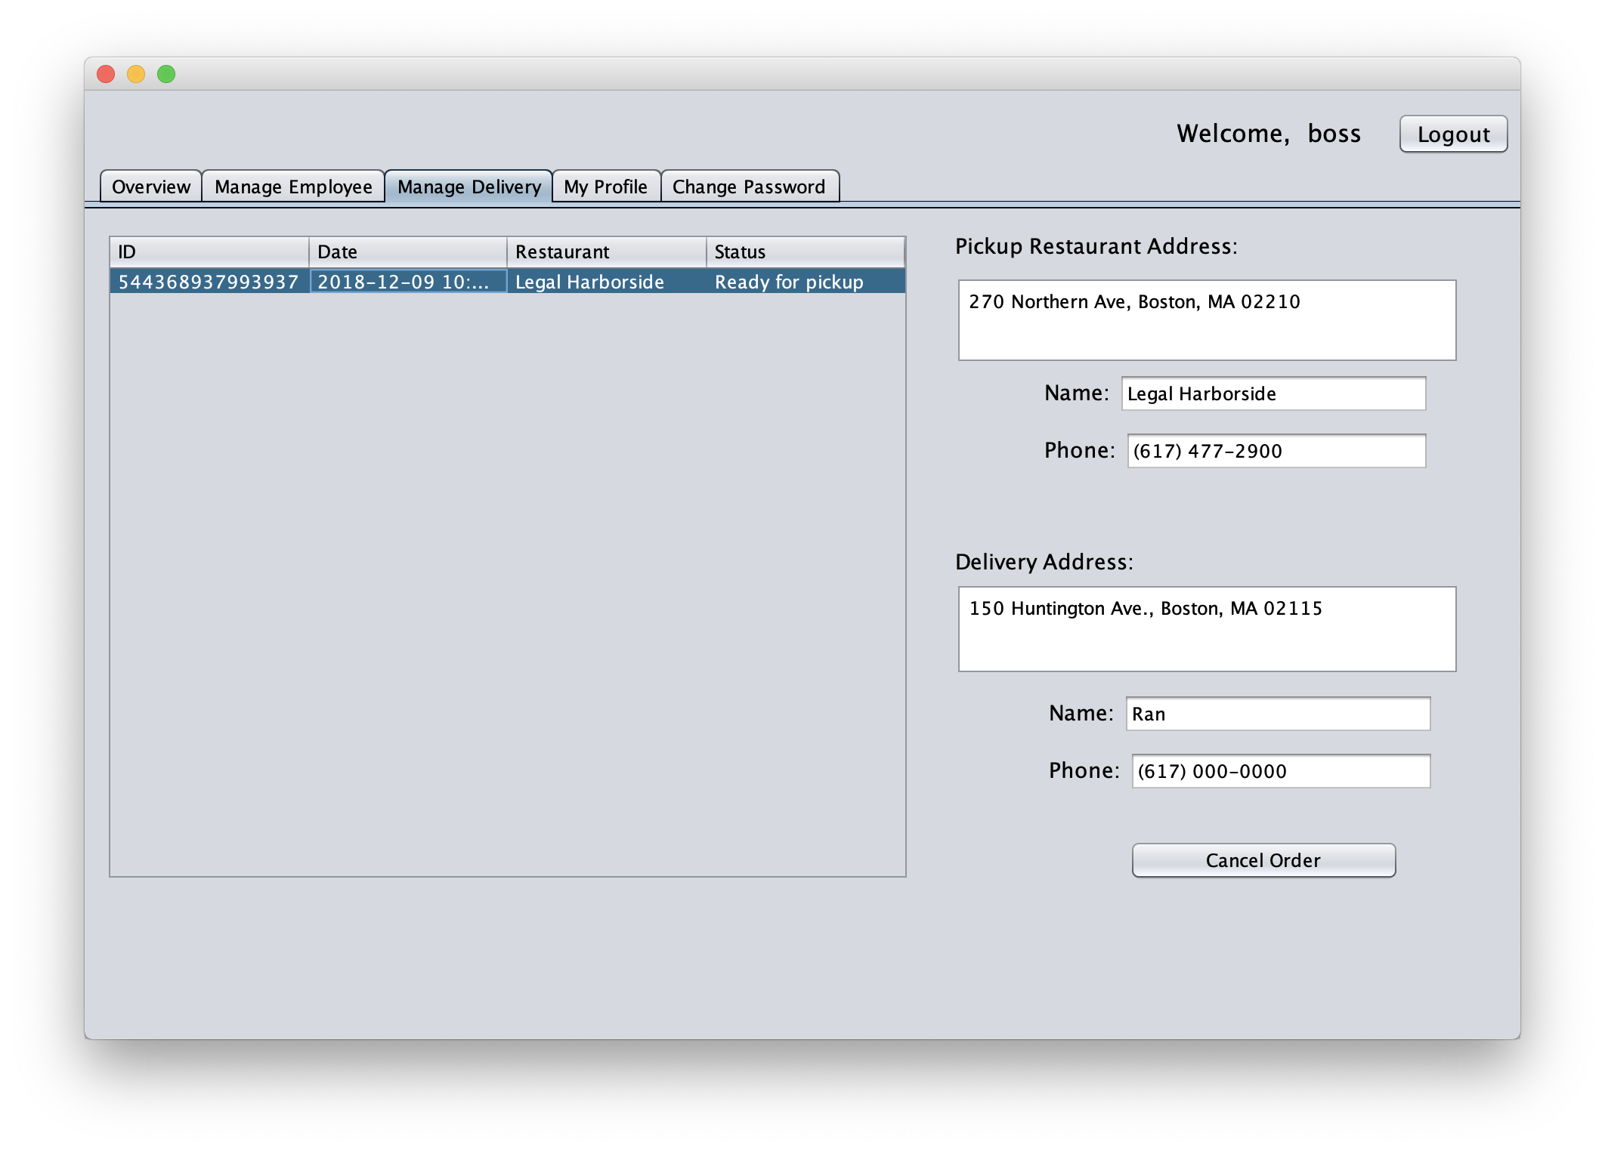
DEMO – Manage Delivery

Slide 34
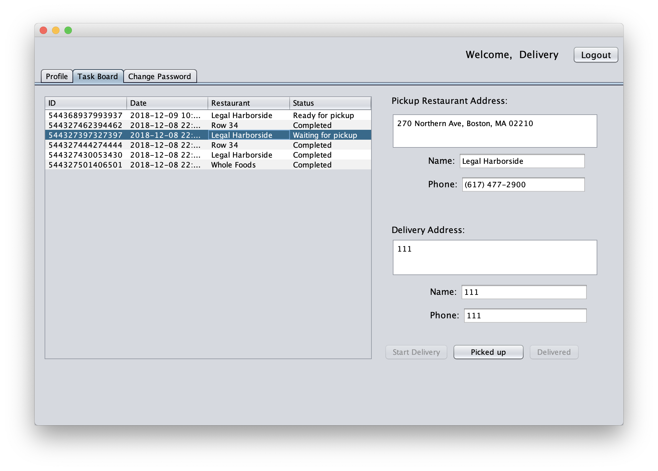
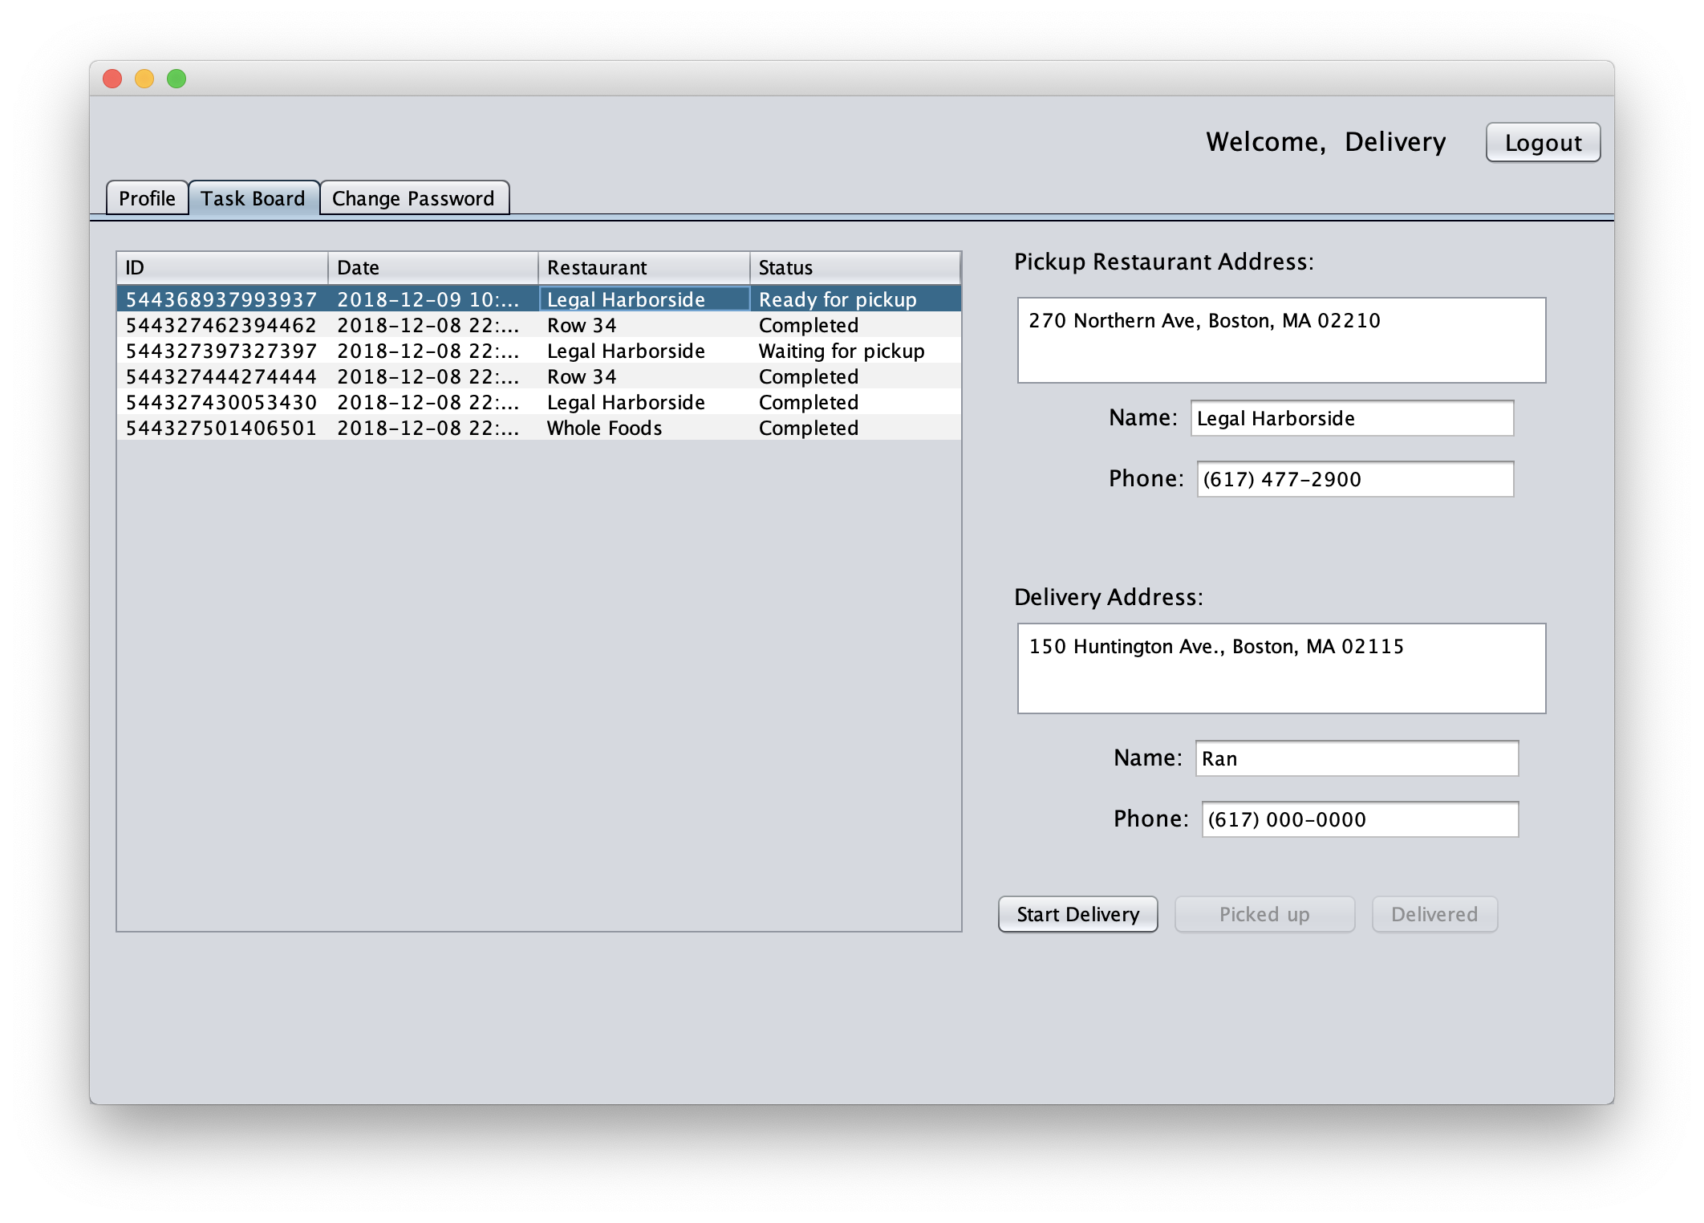
DEMO – Delivery Man Order Management

Slide 35
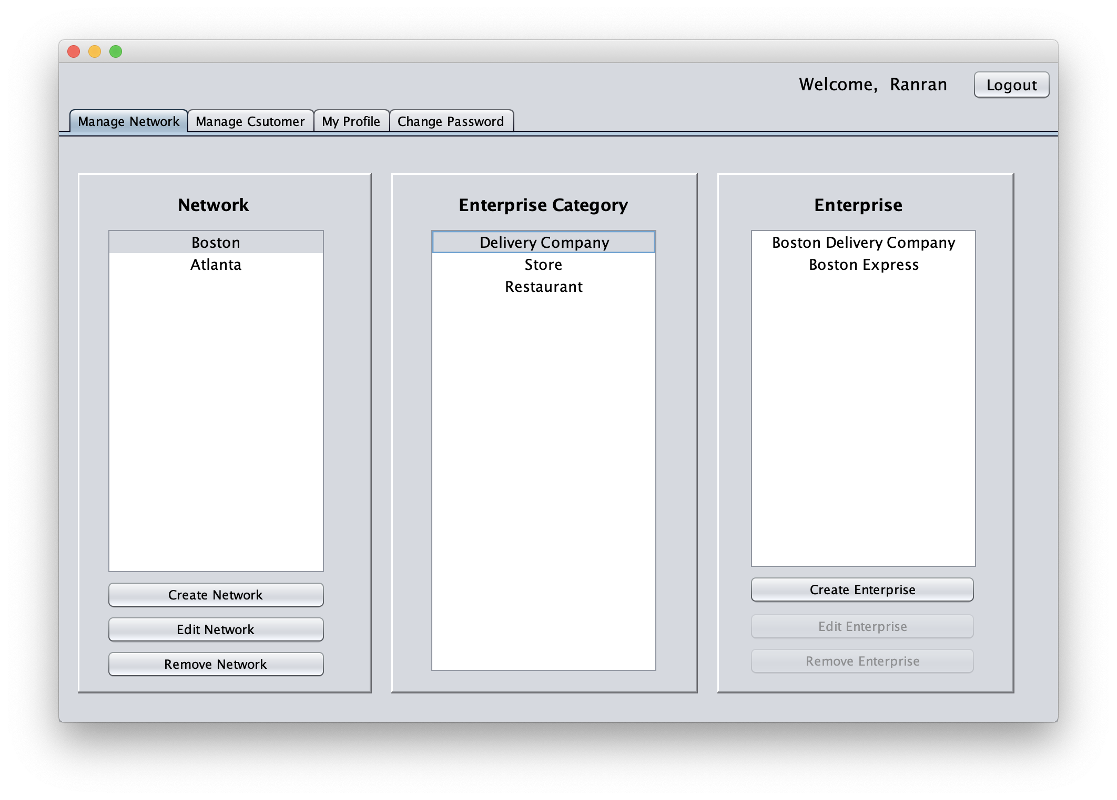
DEMO – System Manager

Slide 36
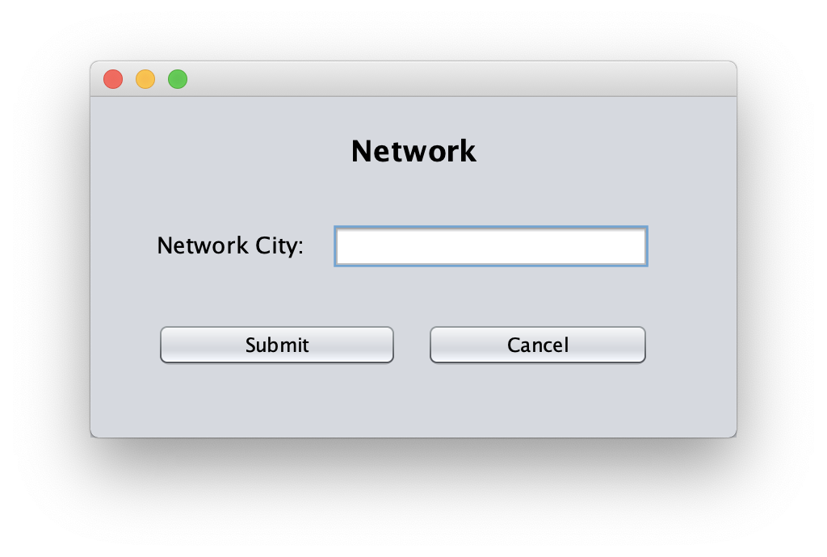
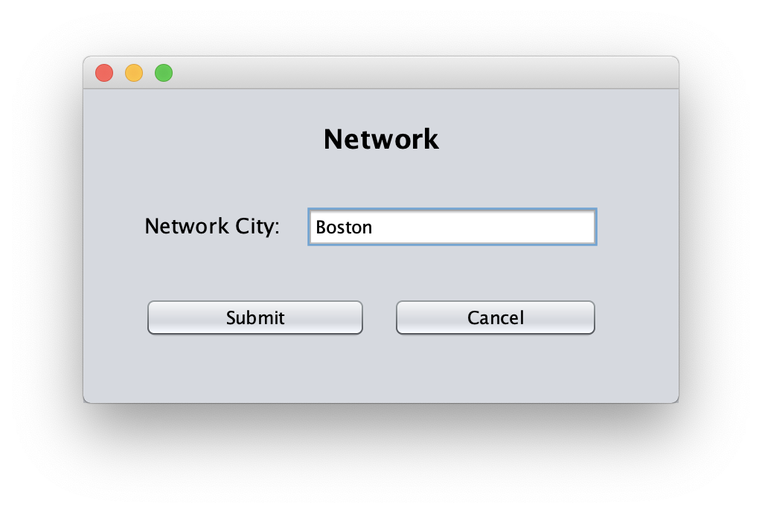

DEMO – Manage Network
Create Network
Edit Network
Remove Network

Slide 37
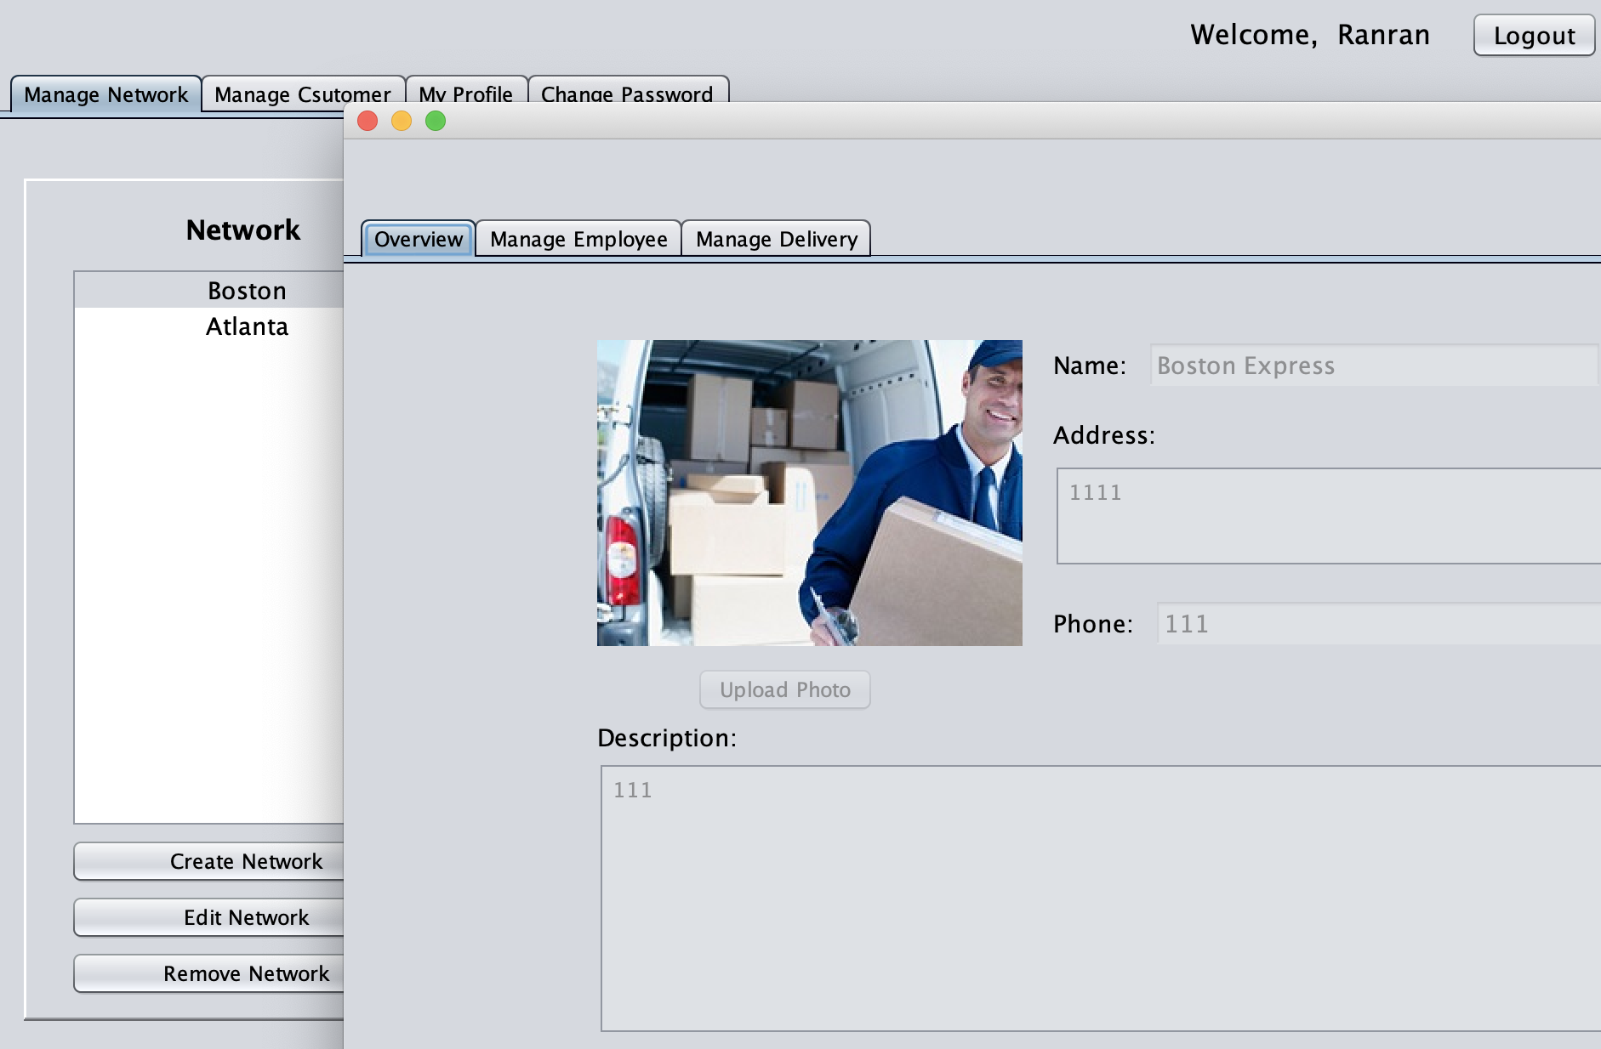
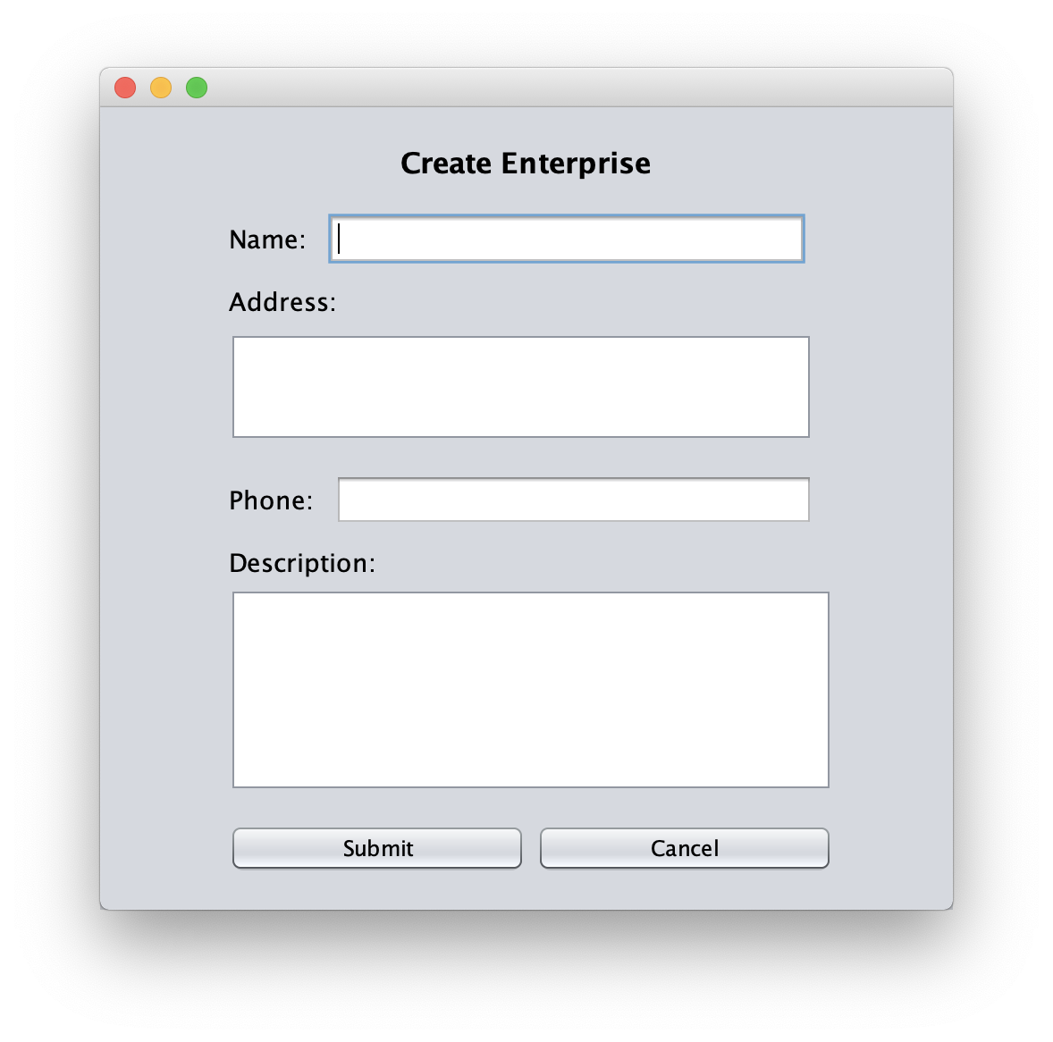
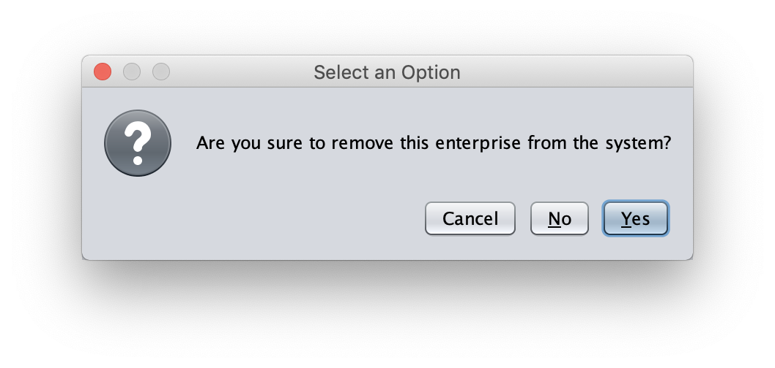
DEMO – Manage Enterprise
Edit Enterprise
Remove Enterprise
Create Enterprise

Slide 38
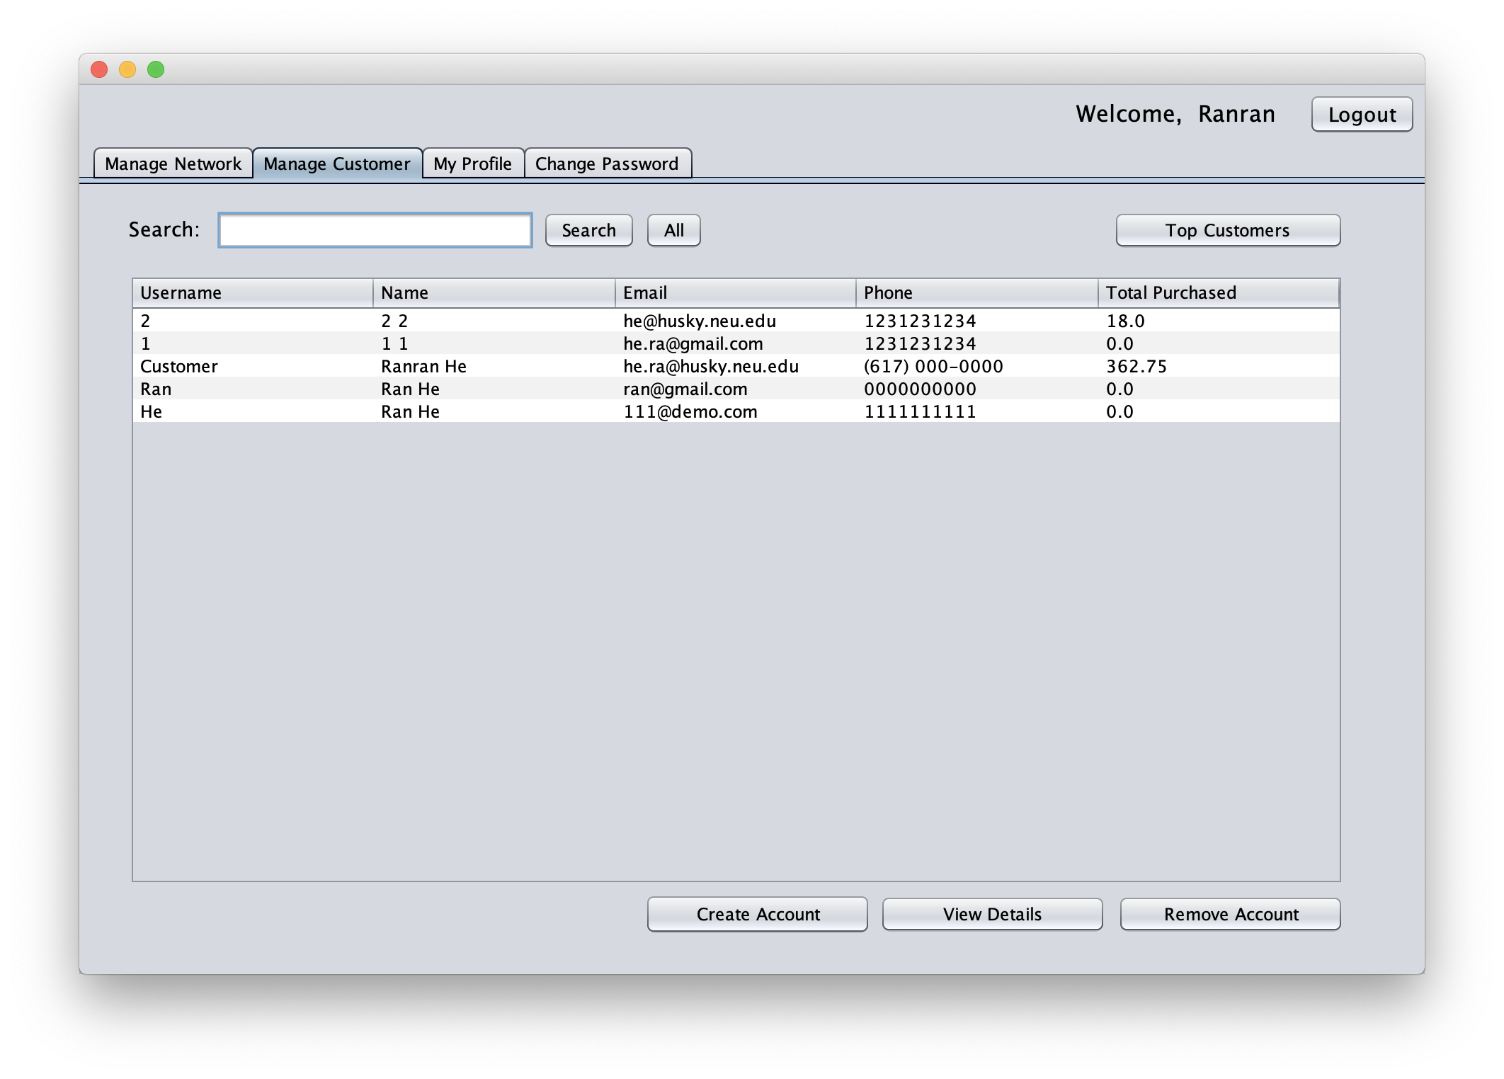
DEMO – Manage Customer Accounts

Slide 39

DEMO – Search
This search engine is
comprehensive. It gives
results based on
Username, name, email
and phone.

Slide 40

DEMO – Top Customer Ranking

Slide 41


DEMO – Create/Remove Customer Account

Slide 42


DEMO – View Customer Account Details

